Slide 1


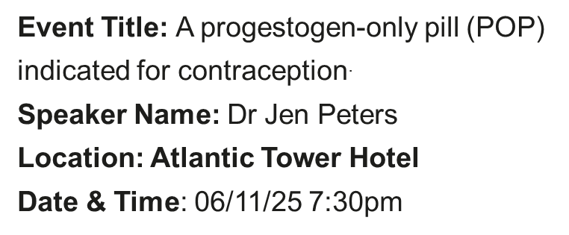


Slynd ® (drospirenone 4 mg)
Scan here for access to the promotional Slynd website intended for healthcare professionals
Prescribing information and adverse event reporting can be found on the last page of this presentation

Slide 2
Meet the speaker
Dr Jen Peters
Bio
GP working in Liverpool in Primary Care and axess sexual health
LoC SDI & IUD holder
CoSRH Registered Trainer
BMS Management of the Menopause Certificate
Disclosures
I have received honoraria from Exeltis,Organon, Besins & MSD.

Slide 3
Meeting objectives
To provide an overview of POPs focusing on drospirenone 4 mg (Slynd®).
To summarise the contraceptive efficacy, tolerability, and features of drospirenone 4 mg, including bleeding.
To discuss the potential role of drospirenone 4 mg as an additional option.

Slide 4
Progestogen-only Pills (POPs)

Slide 5
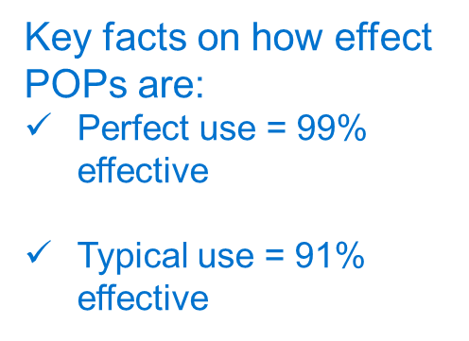
Available POPs and their mechanism of action
Type of POPs | Inhibition of ovulation | Effects on the endometrium | Effects on the viscosity of cervical mucous
Traditional (e.g. Norethisterone, Levonorgestrel) |  | ✓ | ✓
Desogestrel (DSG) | ✓ | ✓ | ✓
Drospirenone (DRSP) | ✓ | ✓ | ✓
POPs, progestogen-only pills; DSG, desogestrel; DRSP, drospirenone.
1. Slynd® Summary of Product Characteristics; 2. Norgeston® Summary of Product Characteristics; 3. Noriday® Summary of Product Characteristics; 4. Cerazette® Summary of Product Characteristics; 5. FSRH Clinical Guidelines progestogen-only pills. 07/2023

Slide 6
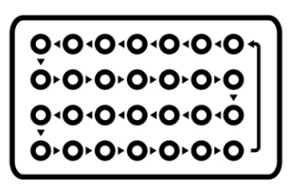
POPs provide advantages over COCPs in certain populations
Oral contraceptives can be divided into combined oral contraceptive pills (COCPs) and progestogen-only pills (POPs).¹
In comparison to COCPs, POPs offer several advantages:¹
Can be used from menarche to age 55 years old⁴
Decreased risk of VTE^{1,2}
Fewer metabolic changes³
COCPs, combined oral contraceptive pills; POPs, progestogen-only pills; VTE, Venous thromboembolism.
1. Palacios S et al., Arch Gynecology and Obstetrics 2019;300:1805–181; 2. Lidegaard Ø et al., N Engl J Med 2012;366(24):2257–2266; 3. Regidor PA Oncotarget 2018;9(77):34628–34638; 4. Slynd® Summary of Product Characteristics.

Slide 7
POPs are suitable for a broader range of individuals than COCPs, including those who are intolerant to or contraindicated for estrogens, such as:^{1,2,3}
Individuals who experience migraines with aura³
Individuals with additional cardiovascular risk factors (hypertension, hyperlipidaemias, obesity, diabetes, smokers)
Post-partum <6 weeks
Individuals with a BMI >35
COCPs, combined oral contraceptive pills; POPs, progestogen-only pills; BMI, body mass index.
1. FSRH Clinical Guidelines progestogen-only pills. 07/2023. 2. Slynd® Summary of Product Characteristics. 3. UK Medical Eligibility Criteria. For Contraceptive Use.
2016 (Amended 2019).

Slide 8
Conditions that are a UKMEC 3 or 4 for POPs are:
Liver tumours/severe cirrhosis
Previous/current breast cancer
New Ischemic heart disease (IHD)/Stroke
UKMEC, United Kingdom Eligibility Citeria; POPs, progestogen-only pills; IHD, Ischemic heart disease.
FSRH Clinical Guidelines progestogen-only pills. 07/2023

Slide 9
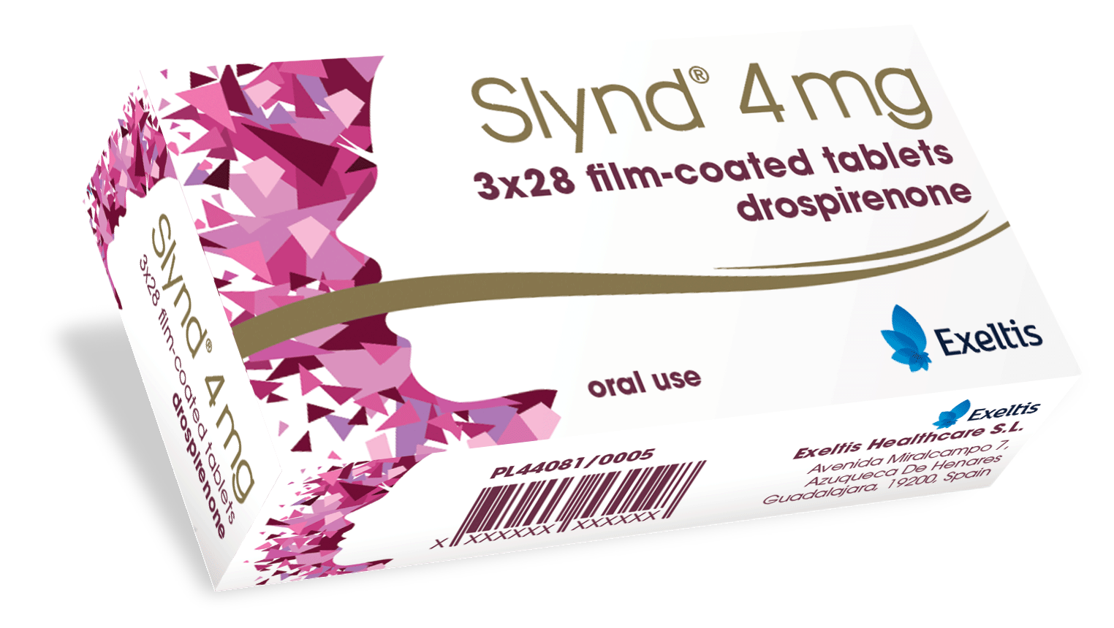

Introduction to Slynd (drospirenone 4 mg)
Drospirenone 4 mg is a progestogen-only pill (POP) indicated for contraception only.^{1,2}
Slynd® is the only POP with drospirenone as its active ingredient.^{1,2}
Drospirenone 4 mg is included in the Faculty of Sexual and Reproductive Healthcare (FSRH) guidelines.^{1, 3}
FSRH, Faculty of Sexual and Reproductive Healthcare; POP, progestogen-only pill.
1. FSRH Clinical Guidelines progestogen-only pills. 07/2023; 2. Slynd® Summary of Product Characteristics; 3. UK Medical Eligibility Criteria.
[M]

Slide 10
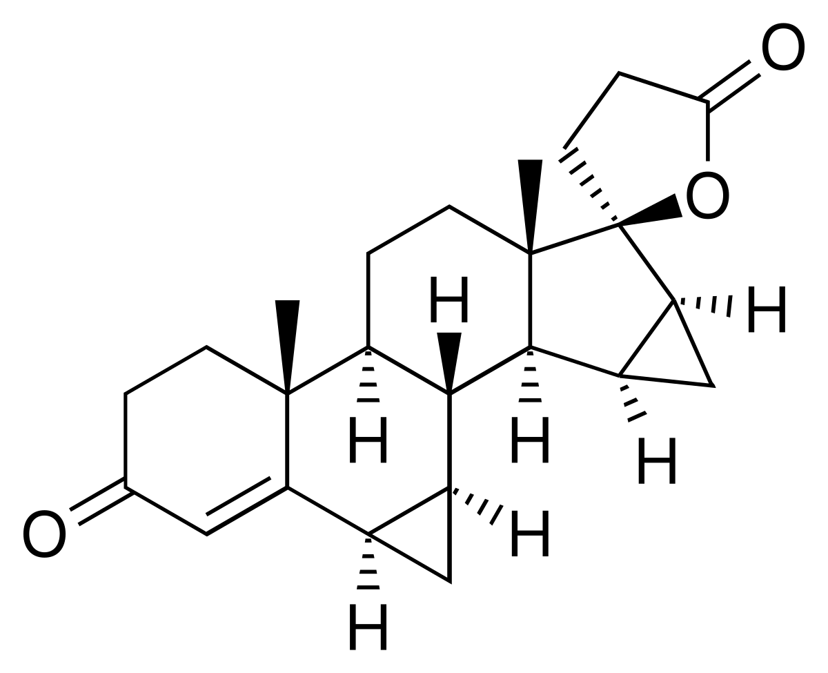
Properties of drospirenone
Drospirenone is a progestogen derived from spironolactone with a receptor binding profile similar to natural progesterone.^{2,3}
Drospirenone, which in therapeutic doses possesses mild:
Anti-androgenic
Anti-mineralocorticoid ^{2,3}
Drospirenone molecule¹
1. Africander, D., Verhoog, N., Hapgood, J.P. Steroids. 2011. 76:636-652. 2. Slynd® Summary of Product Characteristics. 3. FSRH Clinical Guidelines progestogen-only pills. 07/2023.
Notes:
10

Slide 11
Clinical development
The contraceptive efficacy of drospirenone 4 mg was assessed in three prospective, multicentre, pivotal phase III clinical studies – two in Europe and one in the US.¹⁻³
Key study characteristics
Primary endpoint
EU studies: Overall Pearl Index (PI)
US study: PI calculated using confirmed on-drug pregnancies and evaluable cycles in women aged ≤35 years
Study treatment
4 mg non-micronised oral drospirenone for 24 days, followed by 4 days of placebo for 9 and 13 cycles respectively
Study populations
EU studies: Healthy women between the ages of 18-45
US study: Sexually active, healthy, non-pregnant women aged ≥15 years seeking contraception
The PI is a common measure of contraceptive failure used in clinical trials. It is defined as the number of contraceptive failures per 100-women years of exposure to a given contraceptive.⁴
PI, Pearl Index; US, United States of America; EU, Europe.
1. Slynd® Summary of Product Characteristics. 2. Palacios, S., Colli, E., and Regidor, PA. AOGS. 2019. 98: 1549-1557. 3. Kimble, T. et al. Contraception: X. 2020. 2:100020. 4. Schreiber, CA., and Barnhart, K. Yen & Jaffe’s Reproductive Endocrinology (Seventh Edition). 2014. 890-908.
Notes:
11

Slide 12


Clinical development
Key study outcomes
Efficacy was assessed in:
2,549
Individuals treated with drospirenone 4 mg for at least 9 cycles
19,876
Evaluable treatment cycles with drospirenone 4 mg
Across the clinical development programme, drospirenone 4 mg was shown to provide effective contraception when used correctly.²
1. Slynd® Summary of Product Characteristics. 2. Palacios, S., Colli, E., and Regidor, PA. AOGS. 2019. 98: 1549-1557. 3. Kimble, T. et al. Contraception: X. 2020. 2:100020. 4. Schreiber, CA., and Barnhart, K. Yen & Jaffe’s Reproductive Endocrinology (Seventh Edition). 2014. 890-908.
Notes:
12

Slide 13
Contraceptive efficacy

Slide 14
Anti-ovulatory effect
Ovulation inhibition of drospirenone 4 mg (n=27) was confirmed in a comparative phase II study over two treatment cycles vs. desogestrel 75 𝜇g (n=29).¹
A 24/4 regimen of drospirenone 4 mg/placebo inhibited ovulation as effectively as a continuous 28-day regimen of desogestrel 75.*
Ovulation did not occur for 9-days after study treatment discontinuation in the drospirenone group (13-days after the last active tablet) demonstrating contraceptive efficacy is maintained through the hormone-free interval (HFI) and beyond.
*As measured by Hoogland scores: 1 No activity; 2 Potential activity; 3 Non-active follicle-like structure (FLS); 4 Active FLS; 5 Luteinised unruptured follicle (LUF); 6 ‘Ovulation’.
FLS, follicle-like structure; HFI, hormone-free interval; LUF, luteinised unruptured follicle; MoA, mechanism of action.
1. Duijkers, I.J.M., et al. Eur J Contracept. and Reprod. Healthcare. 2015. 20(6): 419-427. 2. Slynd® Summary of Product Characteristics. ​
Notes:
14

Slide 15
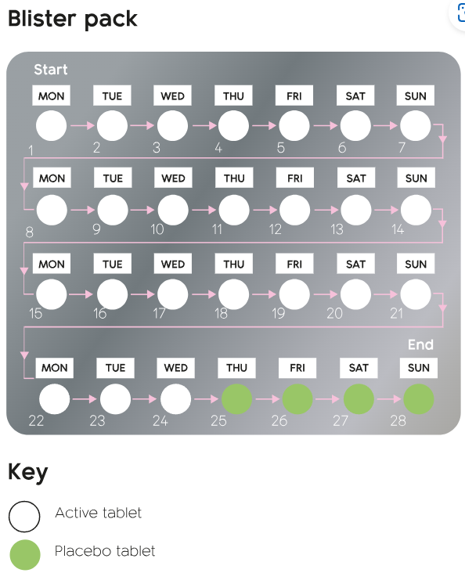
Dosing and administration
Drospirenone 4 mg tablets are administered orally in a 28-day cycle with a 24+4 active/placebo dose regimen as follows:¹
One active (white) tablet on day 1–24
One placebo (green) tablet on day 25–28
Packs should be taken consecutively without a break.
2023 FSRH Guidelines:
“The aim of the four hormone-free days is to try to establish a more predictable bleeding pattern (although the evidence suggests that this is not necessarily the case) whilst maintaining contraceptive effectiveness. In the absence of evidence for, or experience of, tailored or continuous pill-taking regimens for drospirenone 4 mg, the guideline development group (GDG) recommends that the manufacturer-recommended 24/4 regimen is used.”²
FSRH, Faculty of Sexual and Reproductive Healthcare; GDG, guideline development group.
1. Slynd® Summary of Product Characteristics. 2. FSRH Clinical Guidelines progestogen-only pills. 07/2023.
Notes:
15

Slide 16
When can Drospirenone be started?
No additional precautions required
Day 1 after natural menstrual cycle
Day 1 after first trimester Abortion
Days 21-28 after second trimester delivery or Abortion
Switching from another correctly used and/or non expired contraception
Additional precautions required for 7 days
Quick-starting any other time
After levonorgestrel emergency contraception (LNG-EC)
After ulipristal acetate EC (UPA-EC) wait 5 days before starting Slynd
LNG-EC, levonorgestrel emergency contraception; UPA-EC, ulipristal acetate emergency contraception.
Slynd® Summary of Product Characteristics.

Slide 17
Missed pill window
Drospirenone 4 mg is the only POP in the UK with a 24-hour missed pill window.^{1,2}
Drospirenone 4 mg should be taken every day at the same time, so that the interval between tablets is 24 hours.¹
3 hours
12 hours
24 hours
Levonorgestrel³
Norethisterone⁴
An elimination half-life of 32-hours
maintains therapeutic plasma levels
and ovulation inhibition activity beyond 24 hours in the case of a missed pill.^{1,6}
Desogestrel⁵
Drospirenone¹
Please refer to the Summary of Product Characteristics for complete information on what to do if a tablet is missed.
POP, progestogen-only pill; UK, United Kingdom.
1. Slynd® Summary of Product Characteristics. 2. FSRH Clinical Guidelines progestogen-only pills. 07/2023. 3. Norgeston® Summary of Product Characteristics.
4. Noriday® Summary of Product Characteristics. 5. Cerazette® Summary of Product Characteristics. 6. Duijkers, I.J.M, et al. Contraception. 2016. 93: 303-309.
Notes:
17

Slide 18
When is a pill missed?
Pill taken as normal
Next pill scheduled
Norethisterone
Levonorgestrel
Desogestrel
Drospirenone
12noon
Fri 9am
Sat 9 am
Sat 9 pm
Sun 9 am
Normal interval between pills
Pill late (missed pill window)
Pill Missed
1. Slynd® Summary of Product Characteristics. 2. FSRH Clinical Guidelines progestogen-only pills. 07/2023. 3. Norgeston® Summary of Product Characteristics.
4. Noriday® Summary of Product Characteristics. 5. Cerazette® Summary of Product Characteristics. 6. Duijkers, I.J.M, et al. Contraception. 2016. 93: 303-309.

Slide 19
Establishing the 24-hour missed pill window
In a study to assess drospirenone efficacy in the event of a missed pill, only one woman (0.8% [CI 0.0-4.4%]; n=127) was observed to ovulate during a cycle in which four pills were deliberately taken more than 24 hours late.¹
Group A Cycle 1/Group B Cycle 2
1
2
3
4
5
6
7
8
9
10
11
12
13
14
15
16
17
18
19
20
21
22
23
24
25
26
27
28
Normal pill intake
Group B Cycle 1/Group A Cycle 2
Double pill intake
No pill intake/placebo
1
2
3
4
5
6
7
8
9
10
11
12
13
14
15
16
17
18
19
20
21
22
23
24
25
26
27
28
Adapted from Duijkers et al. 2015.¹
Slynd® effectively prevents ovulation even when a pill is taken up to 24 hours late.¹
CI, confidence interval.
Duijkers, I.J.M., et al. Contraception. 2015. 93(4): 303-309.
Notes:
19

Slide 20
What to do if they miss a pill
Less than 24 hours late
Take the late pill as soon as remembered and take the next tablet at the usual time
More than 24 hours late
Take the late pill as soon as remembered even if it means taking two pills at the same time
Days 1-14 (first and second row)
Take the late pill as soon as remembered even if it means taking two pills at the same time and throw away the placebo pills and start a new packet
Days 15-24 (third and fourth row)
Any missed pills where it is more than 24 hours (48 hours from the last taken pill), emergency contraception to be considered, additional precautions (condoms) and 7 days of white active pills will be required
Slynd® Summary of Product Characteristics.
Notes:
20

Slide 21
What to do if they miss a placebo pill or experience vomiting/diarrhoea
Missed a placebo tablet
Throw away the missed placebo tablet and continue
Days 25-28 (fourth row)
Within 3-4 hours of taking Slynd
Take another active pill from another blister pack within 24 hours
More than 24 hours
Follow missed pill guidance
Days 1-24 (Vomiting or Diarrhoea)
Any missed pills in the first week of starting tablets and sex has occurred in the preceding week, emergency contraception should be considered, additional precautions (condoms) and 7 days of white active pills will be required
Slynd® Summary of Product Characteristics.
Notes:
21

Slide 22
Bleeding with drospirenone 4 mg
Bleeding with drospirenone 4 mg – as with all POPs can be unpredictable and bleeding experiences will be variable.
Individuals may experience scheduled bleeding (during the HFI), unscheduled bleeding, or no bleeding at all. Bleeding may be light or moderate, and both scheduled and unscheduled bleeding can occur.^{1,2}
After 9- 12 months of drospirenone 4mg use, about 30% of women will experience amenorrhoea.^{1, 2}
HFI, hormone-free interval; POPs, progestogen-only pills.
1. FSRH Clinical Guidelines progestogen-only pills. 07/2023. 2. Slynd® Summary of Product Characteristics.
Notes:
22

Slide 23
Bleeding profile: drospirenone 4 mg vs. desogestrel 75 𝜇g
The bleeding profile of a 24/4 regimen of drospirenone 4 mg/placebo (n=858) vs. continuous 28-day regimen of desogestrel 75 𝜇g (n=332) over 9 cycles was assessed in a multicentre, double-blind, randomised (5:2), phase III study.
Primary endpoint
Secondary endpoint
The proportion of individuals with unscheduled bleeding/ spotting days in each cycle from cycles 2–9 and cumulative in cycles 2–4 and cycles 7–9.
Number of bleeding/spotting days during cycles 2–4,
7–9 and 2–9 and proportion of subjects with no bleeding/ spotting.
Palacios, S., et al. Arch Gynae Obs. 2019. 300:1805-1812.
Notes:
23

Slide 24
Study outcomes: Primary endpoint measure
Desogestrel 75 𝜇g
Drospirenone 4 mg
Drospirenone (%;n)
Desogestrel (%;n)
p-value
51.4% (692)
74.0% (285)
<0.0001
50.1% (637)
63.7% (251)
0.0002
48.0% (606)
66.0% (244)
<0.0001
44.5% (566)
53.9% (219)
0.0185
45.3% (530)
55.3% (199)
0.0161
43.9% (503)
49.2% (185)
0.2198 (NS)
43.2% (468)
48.9% (178)
0.1919 (NS)
43.9% (442)
45.3% (161)
0.7511 (NS)
67.9% (527)
86.5% (222)
<0.0001
65.0% (374)
67.9% (137)
0.5392
Primary endpoint: The proportion of individuals with unscheduled bleeding/ spotting days in each cycle from cycles 2–9 and cumulative in cycles 2–4 and cycles 7–9. Adapted from Palacios et al. 2019.¹
FSRH, Faculty of Sexual and Reproductive Healthcare; NS, non-significant.
1. Palacios, S., et al. Arch Gynae Obs. 2019. 300:1805-1812. 2. FSRH Clinical Problematic Bleeding with Hormonal Contraception. 07/2015.
Notes:
24

Slide 25
Days of unscheduled bleeding by treatment period
Individuals experienced significantly fewer mean days of unscheduled spotting and bleeding with drospirenone 4 mg vs. desogestrel 75 𝜇g in each treatment period.
Mean no. of days with unscheduled bleeding/spotting:
Cycle 2–4: Drospirenone 4 mg – 9.6 (n=858); Desogestrel 75 𝜇g – 16.9 (n=332); p<0.0001
Cycle 2–6*: Drospirenone 4 mg – 13.7 (n=858); Desogestrel 75 𝜇g – 23.7 (n=332); p<0.0001*
Cycle 2–9: Drospirenone 4 mg – 21.5 (n=858); Desogestrel 75 𝜇g – 34.7 (n=332); p=0.0003
Cycle 7-9: Drospirenone 4 mg – 7.2 (n=858); Desogestrel 75 𝜇g – 10.8 (n=332); p=0.0277
Desogestrel 75 𝜇g
Drospirenone 4 mg
13.2
days
10.0
days
7.3
days
3.6
days
Cycle 2-4
Cycle 2-6*
Cycle 2-9
Cycle 7-9
Secondary endpoint: Number of bleeding/spotting days during cycles 2–4, 7–9 and 2–9 and proportion of subjects with no bleeding/spotting. Adapted from Palacios et al. 2019. *Cycle 2-6 was not a defined endpoint.
Palacios, S., et al. Arch Gynae Obs. 2019. 300:1805-1812.
Notes:
25

Slide 26
Experience of episodes of prolonged bleeding
Fewer individuals experienced episodes of prolonged bleeding (lasting >10 days) across each treatment period with drospirenone 4 mg vs. desogestrel 75 𝜇g. This difference was significant during cycles 5–7 and 7–9.
Proportion of individuals experiencing episodes of prolonged bleeding per treatment cycle:
Cycle 2–4: Drospirenone 4 mg – 12.1% (n=527); Desogestrel 75 𝜇g – 16.7% (n=222); p=0.0980 (NS)
Cycle 5–7: Drospirenone 4 mg – 6.1% (n=423); Desogestrel 75 𝜇g – 12.1% (n=157); p=0.0172
Cycle 7–9: Drospirenone 4 mg – 2.9% (n=374); Desogestrel 75 𝜇g – 10.9% (n=137); p=0.0003
Desogestrel 75 𝜇g
Drospirenone 4 mg
4.5%
6.0%
8.0%
Adapted from Palacios et al. 2019.
NS, non-significant.
Palacios, S., et al. Arch Gynae Obs. 2019. 300:1805-1812.
Notes:
26

Slide 27
Study drop-out due to abnormal uterine bleeding
Significantly fewer individuals dropped out of the study in the drospirenone 4 mg group due to abnormal uterine bleeding vs. the desogestrel 75 𝜇g group.
Study drop-out due to abnormal uterine bleeding:
Drospirenone 4 mg– 3.3% (n=27)
Desogestrel 75 𝜇g – 6.6% (n=22); p<0.05
Desogestrel 75 𝜇g
Drospirenone 4 mg
Adapted from Palacios et al. 2019.
Palacios, S., et al. Arch Gynae Obs. 2019. 300:1805-1812.
Notes:
27

Slide 28
Drospirenone 4 mg in adolescents
The safety and tolerability of drospirenone 4 mg were assessed in an adolescent population (age 12–17) during a 6-cycle multicentre, open-label study (with an optional 7-cycle extension phase).
This population has been historically under-represented during clinical development of contraceptives, despite widespread use of hormonal contraceptives among adolescents.
Subject assessment of drospirenone 4 mg tolerability (n=102)¹
Apter, D., et al. Contraception. 2020. 1010(6): 412-419.

Slide 29
Tolerability
Drospirenone has an acceptable tolerability profile.
Drospirenone was generally well-tolerated by participants during clinical trials.
The most commonly reported adverse events (AEs) in long-term clinical trials of >9 cycles of treatment with drospirenone 4 mg (2,700 individuals) were acne (3.8%), metrorrhagia (2.9%), headache (2.7%) and breast pain (2.2%).
Common AEs (≥1/100 to <1/10):
Libido disorder
Mood disturbances
Headache
Nausea
Abdominal pain
Acne
Breast discomfort
Metrorrhagia
Vaginal haemorrhage
Dysmenorrhea
Irregular menstruation
Weight increase
AEs, adverse events.
Slynd® Summary of Product Characteristics.
Adverse reactions that have been reported in short- and long-term clinical trials with drospirenone 4 mg. For further information please consult the Summary of Product Characteristics before prescribing.
Notes:
29

Slide 30
Tolerability
Uncommon AEs (≥1/1,000 to <1/100):
Vaginal infections
Uterine leiomyoma
Anaemia
Hypersensitivity
Appetite disorder
Hyperkalaemia
Anxiety symptoms
Depression
Depressed mood
Dizziness
Hot flush
Hypertension
Vomiting
Diarrhoea
Rare AEs (≥1/10,000 to <1/1,000):
Contact lens intolerance
Polyuria
Breast cyst
Cervical dysplasia
Galactorrohoea
Vulvovaginal pruritis
Weight decrease
Constipation
Alopecia
Hyperhidrosis
Rash
Seborrhoea
Pruritis
Dermatitis
Amenorrhoea
Menstrual disorders
Pelvic pain
Ovarian cyst
Vulvovaginal dryness
Vaginal discharge
Fatigue
Oedema peripheral
Transaminases increased
Blood bilirubin increased
Blood creatine phosphokinase increased
Gamma-glutamyltransferase increased
Blood triglycerides increased
AEs, adverse events.
Slynd® Summary of Product Characteristics.
Adverse reactions that have been reported in short- and long-term clinical trials with drospirenone 4 mg. For further information please consult the Summary of Product Characteristics before prescribing.
Notes:
30

Slide 31
Special warnings and precautions for use
Special warnings and precautions for use
If any of the conditions/risk factors mentioned is present, the benefits of drospirenone 4 mg should be weighed against the possible risks for each individual and discussed with the individual before they decide to start using drospirenone 4 mg.
In the event of aggravation, exacerbation, or first appearance of any of these conditions, the individual should contact her physician. The physician should then decide whether drospirenone 4 mg use should be discontinued.
Hyperkalaemia*
Circulatory disorders
Loss of bone density
Breast cancer
Other tumours
Disturbances in liver function
Hypertension
Chloasma gravidarum
Depressed mood
Depression
Suspected ectopic pregnancy (presenting with amenorrhoea or abdominal pain)
Diabetic patients (particularly with vascular involvement)
For further information please consult the Summary of Product Characteristics before prescribing.
Slynd® Summary of Product Characteristics
* In most cases, no increase of potassium levels is to be expected. It is recommended to check serum potassium levels during the first treatment cycle.
Notes:
31

Slide 32
Contraindications for use
Contraindications
POPs, like drospirenone 4 mg should not be used in the presence of any of the conditions listed below. Should any of the conditions appear for the first time during drospirenone 4 mg use, the medicinal product should be discontinued immediately.
Severe renal insufficiency or acute renal failure
Active venous thromboembolic disorder
Presence or history of severe hepatic disease as long as liver function values have not returned to normal
Known or suspected sex-steroid sensitive malignancies
Undiagnosed vaginal bleeding
Hypersensitivity to the active substance or to any of the excipients
For further information please consult the Summary of Product Characteristics before prescribing.
POPs, progestogen-only pills.
Slynd® Summary of Product Characteristics
Notes:
32

Slide 33
Cardiovascular risk

Slide 34



Venous thromboembolism (VTE) risk
VTE risk associated with drospirenone 4 mg was assessed during phase III clinical development.¹⁻⁶
2,549
Individuals treated with drospirenone 4 mg
during clinical development¹
683 Individuals included with at least one VTE risk factor across clinical studies²⁻⁵
19,876
Evaluable treatment cycles with drospirenone 4 mg^{1,4}
0 cases of VTE, ATE, MI, stroke, or PE.⁴
VTE risk factors: family history of thromboembolic illness, current smoker ≥35 years or non-smoker ≥40 years or BMI ≥30 kg/m² (investigator assessed).^{3,4}
POPs with drospirenone as their active ingredient are UKMEC category 2 for individuals with multiple CV risk factors.⁶
ATE, arterial thromboembolism; CV, cardiovascular; MI, myocardial infarction; PE, pulmonary embolism; POP, progestogen-only pill; UKMEC, UK Medical Eligibility Criteria; VTE, venous thromboembolism; BMI, body mass index.
1. Slynd® Summary of Product Characteristics. 2. Archer, D.F., Ahrendt, H.J., and Drouin, D. Contraception. 2015. 92: 439-444. 3. Kimble, T., et al. Contraception. 2020: X 2; 100020. 4. Palacios, S., et al. BMC Women’s Health. 2020. 20:218. 5. Palacios, S., et al. Arch Gynae Obs. 2019. 300: 1805-1812. 6. UK Medical Eligibility Criteria. For Contraceptive Use. 2016 (Amended 2019).
Notes:
34

Slide 35

Effects on blood pressure in the clinical trial programme¹
 |  | SBP <130 and DBP <85 (mmHg) | SBP ≥130 and DBP ≥85 (mmHg)
Changes from baseline |  | N=548 | N=137
SBP (mmHg) | Mean (SD) | 1.77 (10.08) | −7.59 (9.19)
 | Median | 0.0 | −8.0
DBP (mmHg) | Mean (SD) | 1.06 (8.20) | −4.85 (7.85)
 | Median | 0.0 | −5.0
SBP <130 y
DBP < 85 (mmHg)
SBS ≥130 y
DBP ≥ 85 (mmHg)
BP=blood pressure; SBP=systolic blood pressure; DBP=diastolic blood pressure; SD=standard deviation
Inclusion criteria in studies <140 mmHg and <90 mmHg²
BP, blood pressure; SBP, systolic blood pressure; DBP, diastolic blood pressure; SD, standard deviation.
1. Palacios S et al. BMC Women´s Health, 2020 Oct 2;20(1):218. 2. Palacios 2019 Acta Obstet Gynecol Scand 2019;98:1549-1557

Slide 36
Summary

Slide 37
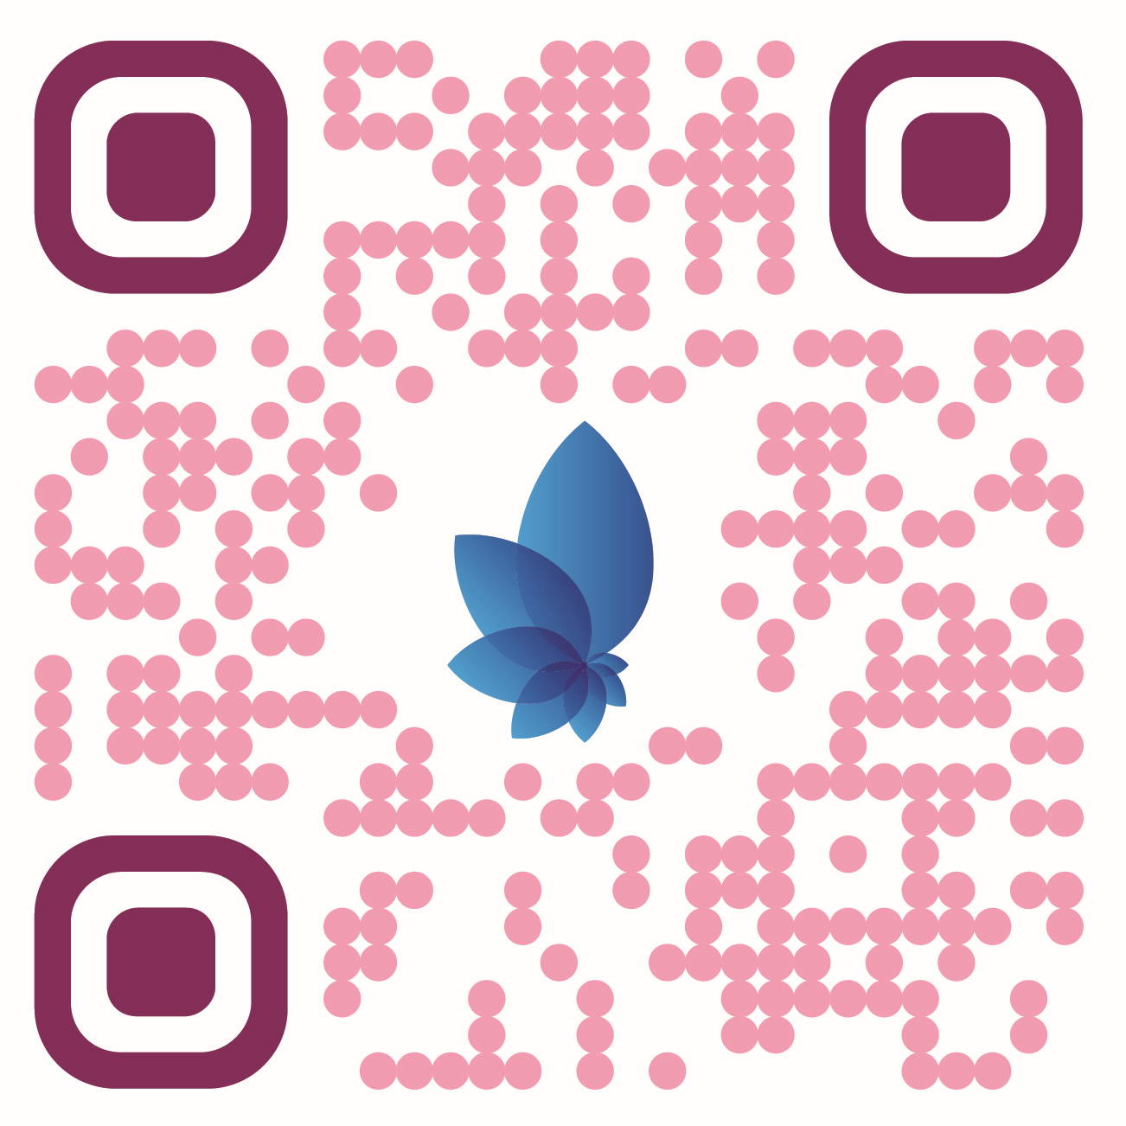



Snap the QR Code to access the FSRH POP Guideline
Drospirenone 4 mg: Summary
Drospirenone 4 mg – marketed as Slynd® – is a progestogen-only pill (POP) indicated for contraception only.^{1,2}
Drospirenone 4 mg is the only POP with a 24-hour missed pill window.^{1,2}
Bleeding with drospirenone can be unpredictable and bleeding experience will differ between individuals, individuals on drospirenone established lower rates of unscheduled bleeding in the early cycles compared to desogestrel. ¹
Drospirenone in therapeutic doses possesses a mild anti-androgenic and
anti-mineralocorticoid activity.^{1,2}
Drospirenone 4 mg has demonstrated effective contraceptive protection when used correctly.^{2,3}
Common AEs with drospirenone 4 mg include libido disorder, mood disturbances, headache, nausea, abdominal pain, acne, breast discomfort, metrorrhagia, vaginal haemorrhage, dysmenorrhoea, menstruation irregular and weight increase.²
Drospirenone 4 mg is administered in a 28-day cycle with a 24+4 active/placebo dose regimen.²
AEs, adverse events; POP, progestogen-only pill.
1. FSRH Clinical Guidelines progestogen-only pills. 07/2023. 2. Slynd® Summary of Product Characteristics. 3. Palacios, S., Colli, E., and Regidor, PA. AOGS. 2019. 98: 1549-1557.
Notes:
37

Slide 38
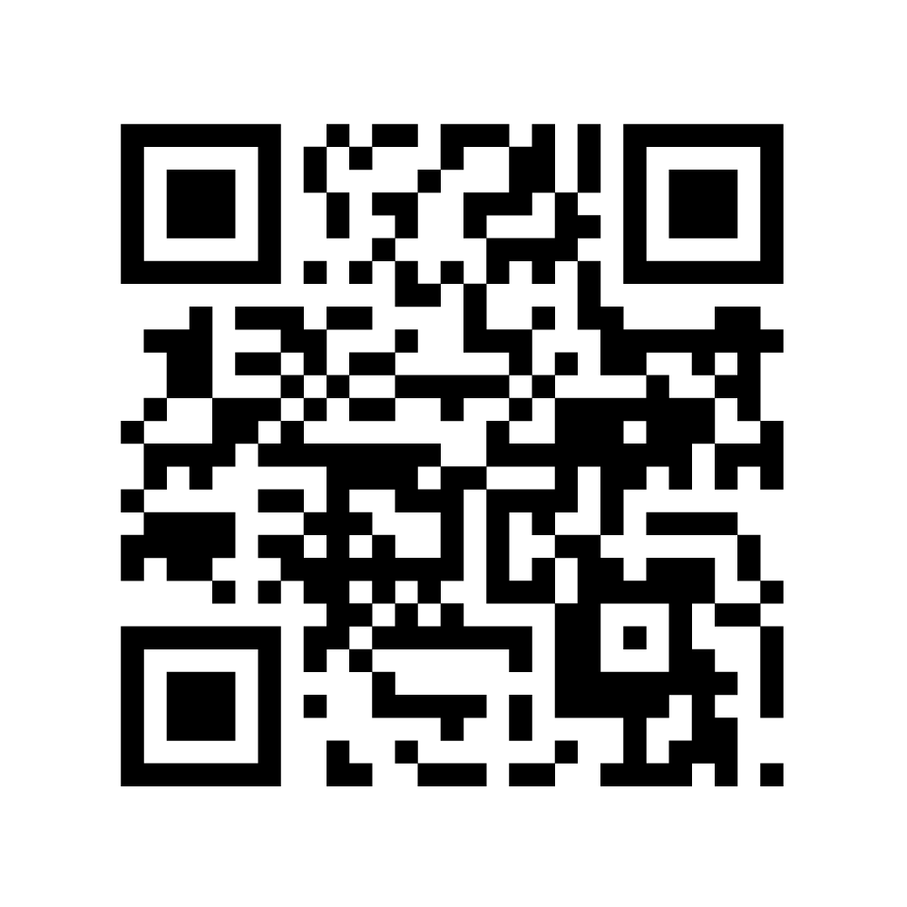
Prescribing Information and Adverse Event Reporting
Scan here for access to the Slynd prescribing information intended for UK healthcare professionals
Adverse events should be reported. Reporting forms and information can be found at https://yellowcard.mhra.gov.uk/ or search for MHRA Yellow Card in the Google Play or Apple App store. Adverse events should also be reported to Exeltis UK Limited by email to uk.pharmacovigilance@exeltis.com
Slynd® Summary of Product Characteristics.

