Slide 1




NHS Community Pharmacy Contract Changes Autumn 2025

Slide 2

Welcome to our Sponsors
Jonathan Nobbs (Director of Membership) and Lucy Whelan (Relationship Manager) – NPA
Joanne Hartley – from Exeltis
Matthew Wright – from Accord
Amrik Tahim – from Avonnex
Ben Strandmann – from Cencora Alliance Healthcare
Notes:
The service is an Advanced service and has been expanded from 1st December 2023.
The service now involves initiation, review and provision of repeat supplies of oral contraception.
The supplies are authorised via two Patient group directions (PGD), with appropriate checks, such as the measurement of the individual’s blood pressure and body mass index being undertaken, where necessary.
Currently the service consultation can only be provided by a pharmacist.
However, to utilize pharmacy staff skill mix and reduce the consultation time for pharmacists, suitably trained and competent pharmacy staff can provide blood pressure and BMI measurement where clinically required in advance of the consultation.
This wider use of skill mix is hopeful a welcome build to the service, and it takes advantage of the change in VAT regulation that occurred in May 2023.
Where clinically appropriate and if the pharmacist and individual requesting the service agree, then the service can be carried out remotely.
In this circumstance, the consultation should be carried out from the pharmacy via telephone, or another live audio link or a live video link in circumstances where the conversation cannot be overheard, except by someone whom the individual wants to hear the conversation.

Slide 3
Agenda
Sponsors
Contraception Service Changes
Speaker – Jen Peters - Slynd - Drospirenone 4mg Progestogen Only Pill Contraception
Pharmacy First Changes
Pharmacy Quality Scheme
Notes:
The service is an Advanced service and has been expanded from 1st December 2023.
The service now involves initiation, review and provision of repeat supplies of oral contraception.
The supplies are authorised via two Patient group directions (PGD), with appropriate checks, such as the measurement of the individual’s blood pressure and body mass index being undertaken, where necessary.
Currently the service consultation can only be provided by a pharmacist.
However, to utilize pharmacy staff skill mix and reduce the consultation time for pharmacists, suitably trained and competent pharmacy staff can provide blood pressure and BMI measurement where clinically required in advance of the consultation.
This wider use of skill mix is hopeful a welcome build to the service, and it takes advantage of the change in VAT regulation that occurred in May 2023.
Where clinically appropriate and if the pharmacist and individual requesting the service agree, then the service can be carried out remotely.
In this circumstance, the consultation should be carried out from the pharmacy via telephone, or another live audio link or a live video link in circumstances where the conversation cannot be overheard, except by someone whom the individual wants to hear the conversation.

Slide 4
Contraception Service Changes

Slide 5
Contraception Changes
EHC goes national
Replaces local services.
Payment higher
No additional training required
Pharmacy Technicians can complete the service.
Addition of drospirenone to the list of contraceptives that can be supplied
New PGDs
Changes to length of treatment
Requirement to access GP record
New SOPs
RP/Technician roles and escalating clinical and safeguarding issues
Notes:
Explain why this is the case to the person
Refer them to their general practice or sexual health clinic (or equivalent)
Clinical record systems should prompt the recording of:
A record of the reason for not supplying against a PGD
A record of the referral to an alternate service provider

Slide 6
Meet the speaker
Dr Jen Peters
Bio
GP working in Liverpool in Primary Care and axess sexual health
LoC SDI & IUD holder
CoSRH Registered Trainer
BMS Management of the Menopause Certificate
Disclosures
I have received honoraria from Exeltis,Organon, Besins & MSD.

Slide 7


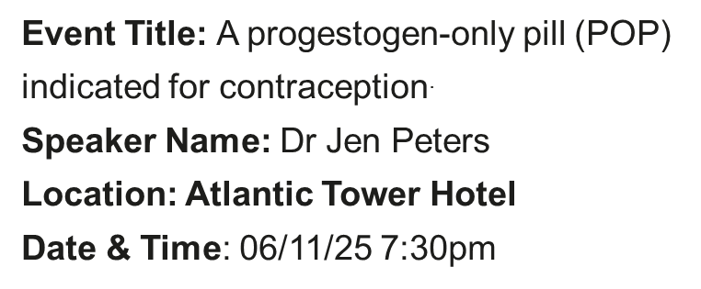


Slynd ® (drospirenone 4 mg)
Scan here for access to the promotional Slynd website intended for healthcare professionals
Prescribing information and adverse event reporting can be found on the full presentation

Slide 8
To provide an overview of POPs focusing on drospirenone 4 mg (Slynd®).
To summarise the contraceptive efficacy, tolerability, and features of drospirenone 4 mg, including bleeding.
To discuss the potential role of drospirenone 4 mg as an additional option.
The full in-depth presentation on the above information can be found here

Slide 9




Snap the QR Code to access the FSRH POP Guideline
Drospirenone 4 mg: Summary
Drospirenone 4 mg – marketed as Slynd® – is a progestogen-only pill (POP) indicated for contraception only.^{1,2}
Drospirenone 4 mg is the only POP with a 24-hour missed pill window.^{1,2}
Bleeding with drospirenone can be unpredictable and bleeding experience will differ between individuals, individuals on drospirenone established lower rates of unscheduled bleeding in the early cycles compared to desogestrel. ¹
Drospirenone in therapeutic doses possesses a mild anti-androgenic and
anti-mineralocorticoid activity.^{1,2}
Drospirenone 4 mg has demonstrated effective contraceptive protection when used correctly.^{2,3}
Common AEs with drospirenone 4 mg include libido disorder, mood disturbances, headache, nausea, abdominal pain, acne, breast discomfort, metrorrhagia, vaginal haemorrhage, dysmenorrhoea, menstruation irregular and weight increase.²
Drospirenone 4 mg is administered in a 28-day cycle with a 24+4 active/placebo dose regimen.²
AEs, adverse events; POP, progestogen-only pill.
1. FSRH Clinical Guidelines progestogen-only pills. 07/2023. 2. Slynd® Summary of Product Characteristics. 3. Palacios, S., Colli, E., and Regidor, PA. AOGS. 2019. 98: 1549-1557.
Notes:
9

Slide 10
Changes to Pharmacy First

Slide 11
Service Changes
Additional Gateway points included for patients that require escalation due to red flags, etc.
Gateway Points have moved in most clinical pathways making it easier to claim.
Ongoing recognition of our advice & expertise - remuneration for advice only element. You don’t have to supply a medicine to claim!
Changes to PGDs – make sure you have the new versions signed and implemented.
Changes help pharmacies to meet bundling requirements
Notes:
The service is an Advanced service and has been expanded from 1st December 2023.
The service now involves initiation, review and provision of repeat supplies of oral contraception.
The supplies are authorised via two Patient group directions (PGD), with appropriate checks, such as the measurement of the individual’s blood pressure and body mass index being undertaken, where necessary.
Currently the service consultation can only be provided by a pharmacist.
However, to utilize pharmacy staff skill mix and reduce the consultation time for pharmacists, suitably trained and competent pharmacy staff can provide blood pressure and BMI measurement where clinically required in advance of the consultation.
This wider use of skill mix is hopeful a welcome build to the service, and it takes advantage of the change in VAT regulation that occurred in May 2023.
Where clinically appropriate and if the pharmacist and individual requesting the service agree, then the service can be carried out remotely.
In this circumstance, the consultation should be carried out from the pharmacy via telephone, or another live audio link or a live video link in circumstances where the conversation cannot be overheard, except by someone whom the individual wants to hear the conversation.

Slide 12
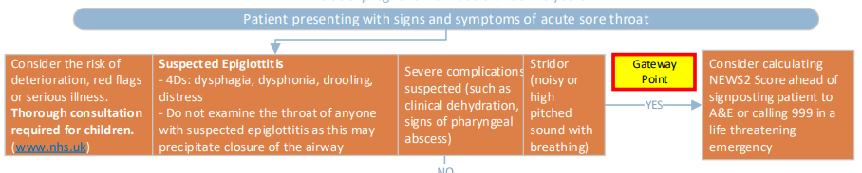
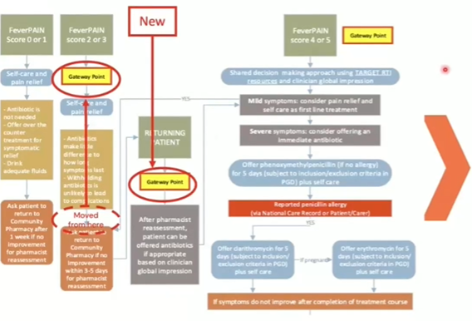
Acute Sore Throat
Key Changes
Addition of Gateway point for escalation to urgent care settings
Clarification of entry point for FeverPAIN score of 2 or 3
Addition of Gateway point for returning patients – even if they still don’t require antibiotic treatment
Notes:
Access
Individuals can access the service by a number of routes
Identified as clinically suitable by the pharmacy team can accept the offer of the service;
Self-refer;
Referred and this can be by their general practice, a sexual health clinic (or equivalent), or from other NHS service providers, e.g. urgent treatment centres or NHS 111.
Note: for the purposes of this service, a referral includes active signposting to attend the pharmacy to receive the service.

Slide 13
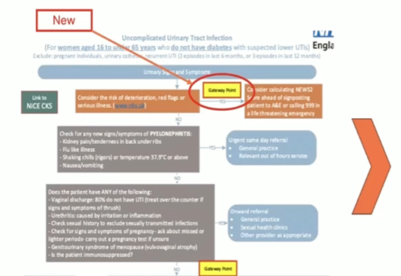
Uncomplicated UTI
To achieve the gateway point:
NEW – any patient with red flag/signs of deterioration or serious illness (refer to CP)
OR - Any patient presenting with possible UTI symptoms meets the gateway point e.g. burning pain passing urine
Key Changes
Addition of Gateway point for escalation to urgent care settings
Addition of wording to women 16-64 years who do not have diabetes
Clearer explanation of gender identities in PGD inclusion and exclusion criteria.

Slide 14
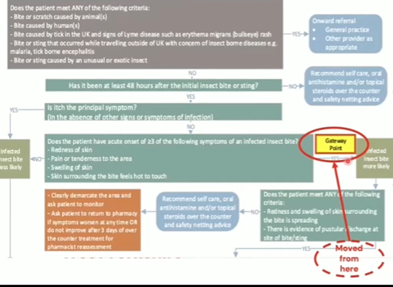
Infected Insect Bites
Key Changes
Addition of Gateway Point for escalation to urgent care settings
Gateway point moved higher up the pathway. Patients who are more likely to have an infected insect bite, but might not need an antibiotic yet, can be given self care advice and asked to return if symptoms worsen.

Slide 15
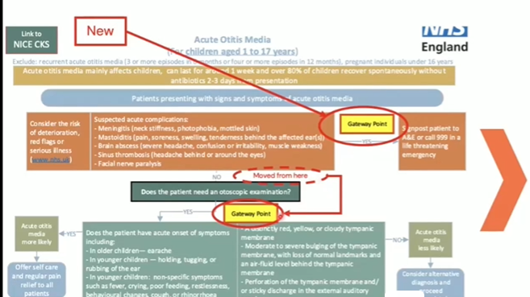
Otitis Media
Key Changes
Addition of Gateway Point for escalation to urgent care settings
Gateway point moved slightly
Acute otitis media mainly affects children, can last for around 1 week and over 80% of children recover spontaneously without antibiotics 2-3 days from presentation.

Slide 16
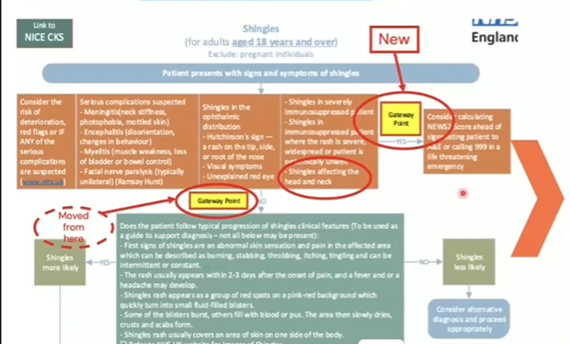
Shingles
Key Changes
Addition of Gateway Point for escalation to urgent care settings
Gateway point moved so all patients presenting with signs and symptoms meet Gateway criteria
Shingles affecting the head and neck are now excluded

Slide 17
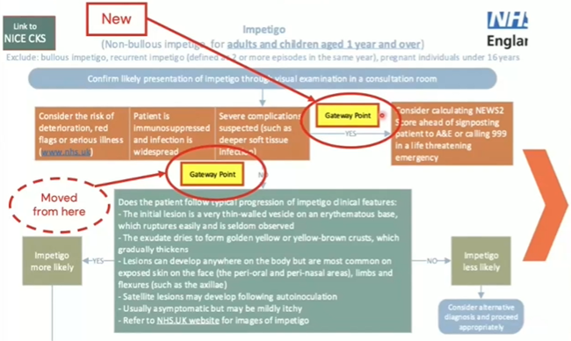
Impetigo
Key Changes
Addition of Gateway Point for escalation to urgent care settings
Gateway point moved so all patients presenting with signs and symptoms meet Gateway criteria

Slide 18
Sinusitis
To meet the gateway point the patient should have a RUNNY or BLOCKED nose PLUS ONE or more of the following:
Facial pain/pressure/headache
Reduced/loss of the sense of smell in adults
Cough during day/night in children
OR
NEW – any patient with red flag/signs of deterioration or serious illness (refer to CP)

Slide 19
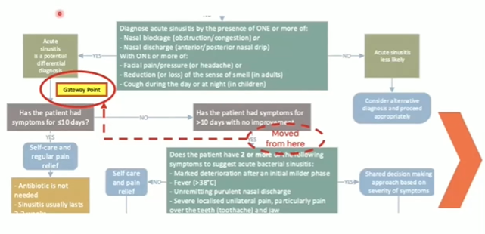
Sinusitis
Key Changes
Addition of Gateway Point for escalation to urgent care settings
Gateway hit no matter how long the patient has had symptoms.
Advice only – acute sinusitis is usually caused by a virus & is only complicated by a bacterial infection in about 2 in 100 cases. Take 2-3 weeks to resolve – most patients get better without antibiotics – remember to claim for providing self-care advice/OTC

Slide 20
Pharmacy Quality Scheme

Slide 21
PQS
Gateway
Signed up & registered to deliver Pharmacy First Clinical Pathways & Contraception Service
Medicines Optimisation Domain
Palliative/End of Life Care
Action plan/update DoS
NMS depression training CPPE
CPPE consulting with people with mental health problems
Respiratory
Referral of patients 5-15 years prescribed pMDI/no spacer
Referral of patients using 3 or more SAB/no corticosteroid 6m
Emergency Contraception
Pharmacists/technicians online assessment CPPE
Patient Safety Domain
Pharmacy First
National audit on antimicrobial stewardship
CPPE training Sepsis & assessment
Enhanced DBS checks
all registered professionals within last 3 years
Notes:
To be eligible for the service, a person must:
An individual seeking to be initiated on an OC, or seeking to obtain a further supply of their ongoing OC.
Eligible products are listed in the PGD and will either be a
Combined oral contraceptive (COC) – age from menarche up to and including 49 years of age; or
Progestogen only pill (POP) – age from menarche up to and including 54 years.

Slide 22
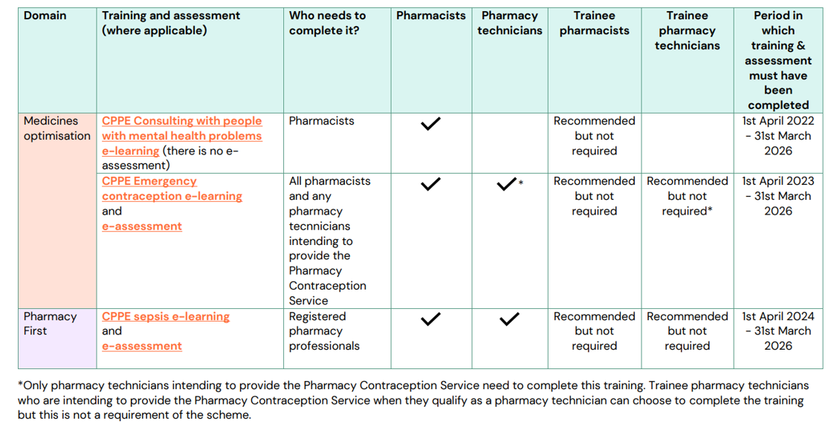
Training
Notes:
Exclusion criteria
A person will not be eligible for this service if:
The individual is considered clinically unsuitable, or is excluded for supply of OC according to the PGD protocols, including, but not limited to:
Individuals under 16 years of age and assessed as not competent using Fraser Guidelines; and
Individuals 16 years of age and over and assessed as lacking capacity to consent.
Additional inclusion and exclusion criteria are listed in the PGDs and as such, pharmacy owners should refer to both the service specification and the PGDs to confirm the full inclusion and exclusion criteria for the service.
Where people are not eligible for the service, pharmacy team members can signpost them to other appropriate local services.

Slide 23
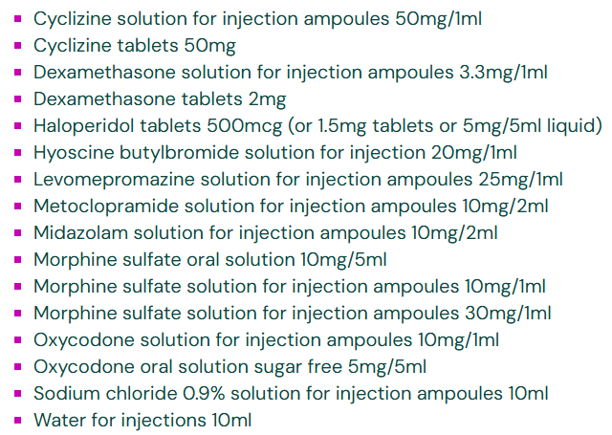
Palliative Care
If you hold 16 palliative care items, declare on NHS Profile Manager
Irrespective of stock holding, update your plan from last year.
The Action Plan must include:
An awareness of any locally commissioned services for palliative care including any on call and delivery arrangements;
A list of community pharmacies stocking the 16 palliative and end of life critical medicines for palliative/end of life care in their area and noting the ability to check the DoS to find pharmacies stocking these medicines;
Details of where parenteral haloperidol can be accessed locally, e.g. through any local commissioning arrangements; and
Awareness of other support services that may be useful for patients/relatives/ carers.

Slide 24
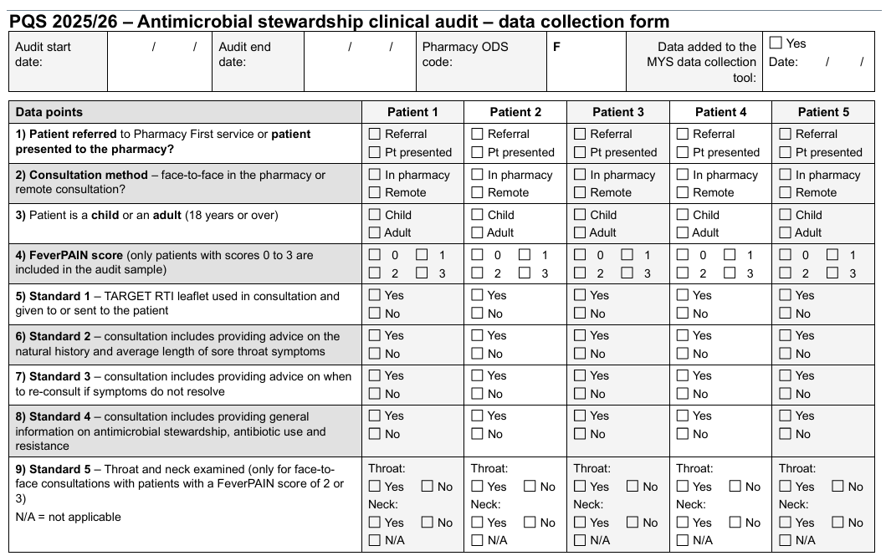
Clinical Audit
Focused on the clinical advice and consultations provided to patients scoring FeverPAIN 0-3 on the Pharmacy First Sore Throat clinical pathway.
Minimum of 10 patients over four weeks, or eight weeks if ten patients are not achieved.
Note start and end date
Record ANONYMOUS details onto MYS
Start no later than 3rd February

Slide 25
Respiratory Domains
Same as the past few years:
5-15 year olds check whether they have a spacer
Refer to GP if not. (LIVERPOOL!!! Don’t forget Spacer Service!!!)
Patients using more than three short-acting bronchodilators
Notes:
Faculty of Sexual and Reproductive Healthcare UK Medical Eligibility Criteria for Contraceptive Use (UKMEC) calculator available to support clinical decision on choice.
HCP professional discretion as to the appropriate product choice of product, from those included in the PGD.
Local ICB formularies/restrictions should be referred to and followed accordingly to ensure the most cost effective option is considered.
Quantity – max 3 months on initiation, up to 12 months supply for on-going / repeat supply.
Ongoing supplies should be made in line with the person’s previous supply
Supplies should be labeled and in original packaging and have the manufacturers patient information leaflet.
Where any advice or signposting occurs, this should also be documented.

Slide 26




What Makes SINTESI Robot Different
SMART EXIT
EUCLID3D
SPLIT/PART
Cut down waste
The only gripper with a Collector unit.
Not just a hole in the side of the robot
MOST EFFICIENT MULTI-MIX PICKING
BATCH PICKING
MORE EFFICIENT DISPENSING WHEN
STOCKING IN COMPACT MODE TO
MAXIMIZE STORAGE SPACE
WHO/WHAT WAS REQUESTED
HOW MANY
WHAT WAS DELIVERED
WHEN ORDERCOMPLETE
SAFELY SHARE EXITS
INDICATES A SPLIT PACK
WILL BE GENERATED
PMR INDEPENDENT
NO ADDITIONAL HARDWARE
RESTOCK WITH AUTOLOADER
SHORTEST EXPIRY DATE FIRST

Slide 27
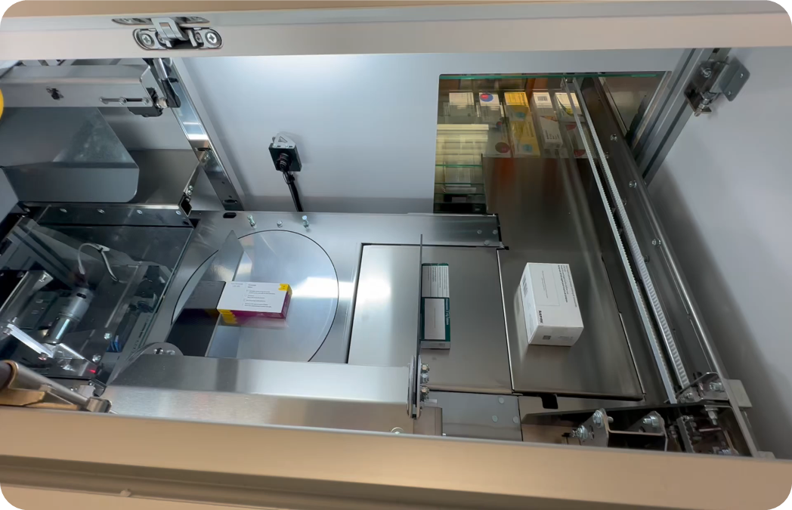
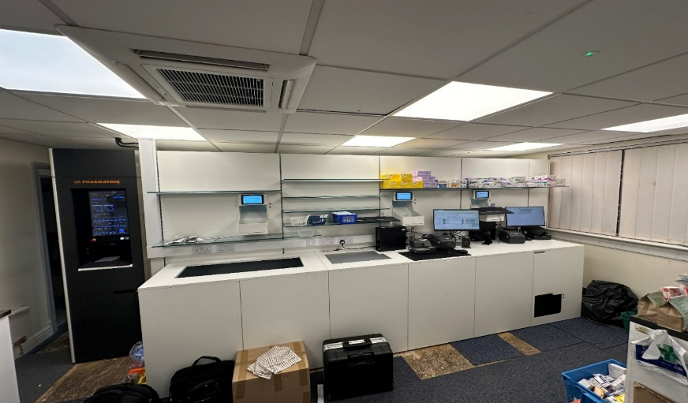
What Makes SINTESI Robot Different
PHARMALOAD
BENCH HEIGHT DESIGN
Production line workflow means upto 4 boxes can be managed at the same time
Low level design , allows loader to double as a work station and free up space in the dispensary
Average time saved 4 hours a day= 20 hours week= 80 hours a month

Slide 28
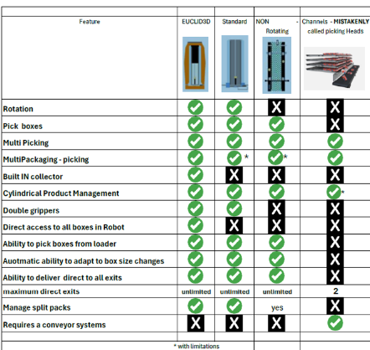




What Makes SINTESI Robot Different
PICKING ARMS/
GRIPPERS/
PICKING HEADS
Euclid3D- picks up to 15 items
in one pick and deliver journey
Rotating Standard Head- picks 2 to 4 items requires multiple movements
Non-Rotating Standard Picking Head – more limitations than the rotating standard picking head
Fixed Channels- A picking head? NOT REALLY
Effectively requires a conveyor system

Slide 29
Is a robot a good Investment for your Pharmacy?
05/23 – 18K iTEMS | Reduced
Dispensing Errors | 99%
Short Dated Stock Wastage | 100%
Staff Time | 30%
Stock Management | 30%
Staff Levels | 40%
10/24 - 15K ITEMS | Reduced
Hours saved per week | 71
Savings per month | £3461
Annual saving | £45,000
ROI | 2.5 years
08/24 -26K ITEMS | Reduced
Locum bill | 50%
Saving Staff | 1
Savings | Monthly leasing /maintenance costs
Let's look at the costs:
Average cost of a robot £100,000
Life span 15+ years
Assuming it only works 40 hours a week (in reality can work 24/7)
SINTESI cost £3.52 an hour
Release time, save costs and generate additional revenue
Is a Dispensing Robot a good investment for your pharmacy?

Slide 30

Cencora Alliance Healthcare
A leading provider of pharmaceutical wholesaling, logistics, clinical trial support, and other innovative healthcare solutions to independent pharmacists and global pharmaceutical manufacturers.
Our purpose is to help people across the world lead healthier and happier lives.
We are proud to be a force for good through our contributions to healthy communities, a healthy planet, an inclusive workplace and a sustainable marketplace.
11/26/2025
30

Slide 31



NWOS
NWOS is one of the market leaders in the supply of surgical appliances and is a registered DAC, with over 30 years experience. We specialise in incontinence, ostomy and woundcare products.
One of the best ways to ensure a financial return can be made when providing surgical appliances to your patients
Allows pharmacy to order eligible items in singles rather than full packs, helping pharmacy to maximize space within the dispensary and improve cash flow
Next day delivery, via Cencora Alliance Healthcare, on an extensive range of Part IX appliances with over 12,500 lines available
Easy and convenient ordering with the NWOS digital portal
Enhanced profitability
Cost-effective solutions
Streamlined processes
Enhanced Profitability
Cost-Effective Solutions
Streamlined Processes

Slide 32
OptiTote
OptiTote is a semi-automated repeat dispensing solution utilising barcode scanning technology that helps streamline the dispensing of Alliance Healthcare stock by delivering repeat prescription items in specific totes ready for collation and dispensing to patients.
Efficient
Frees up time for the pharmacist and dispensing team due to the new systems partial automation of the dispensing process
Simple
Frees No need to put stock away or retrieve for dispensing
Safe
Easy to use with additional accuracy safeguards through barcode technology
Caring
An innovative solution that keeps patients close to the heart of the pharmacy by providing time to spend with them
Value
Offers potential new business opportunities by reinvesting the time reclaimed

Slide 33






SWITCH
SWITCH is the Cencora Alliance Healthcare Order Management System, designed as a purchase and stock management solution. It integrates with your pharmacy PMR to provide detailed product-level ordering control.
Set custom buying rules tailored to your business needs
Utilise the 'Warehouse' feature for managing self-supply and group inter-branch stock transfers
Scans price and stock availability across multiple suppliers in a single platform
Access a full reporting suite for procurement visibility
Control
Flexibility
Financial benefits
Your business, your way
Time management
Support
Visibility

