Slide 1
Sexual Health
Knowsley

Slide 2
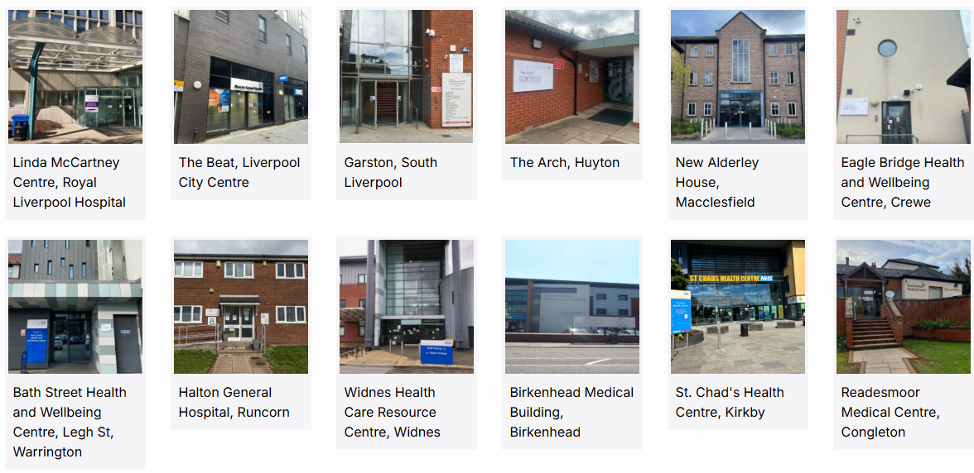

Slide 3
Axess Services Knowsley
Axess Sexual Health Huyton (The ARCH) The Arch Huyton L36 9GA 0300 323 1300 - Option 3
Axess Sexual Health Kirkby (St Chad's)
St Chads Drive
Kirkby
L32 8RE
0300 323 1300 - Option 3

Slide 4
Axess Sexual Health Huyton (The ARCH)
Opening Times for walk-in clinics (times may vary depending on demand and capacity in clinic):
Monday, 09:00-19:00
Thursday, 11:00-19:00
Clinic opening times for appointments:
Tuesday, 09:00 -16:00
Wednesday, 09:00 -15:00
Friday, 09:00 -16:00
Axess Young Person's clinic (19 and under):
Wednesday 3:30 p.m. - 6 p.m.
Opening times for telephone assessment and our appointment booking line:
Monday, 09:00-13:00
Tuesday, 09:00- 13:00
Wednesday, 09:00-13:00
Thursday, 11:00-13:00
Friday, 09:00-13:00

Slide 5
Axess Sexual Health Kirkby (St Chad's)
Clinic opening times for LARC appointments:
Wednesday 9 a.m. - 1 p.m.
Axess Young Person's clinic (19 and under):
Wednesday 3:30 p.m. - 6 p.m.
Opening times for telephone assessment and our appointment booking line:
Monday, 09:00-13:00
Tuesday, 09:00- 13:00
Wednesday, 09:00-13:00
Thursday, 11:00-13:00
Friday, 09:00-13:00

Slide 6
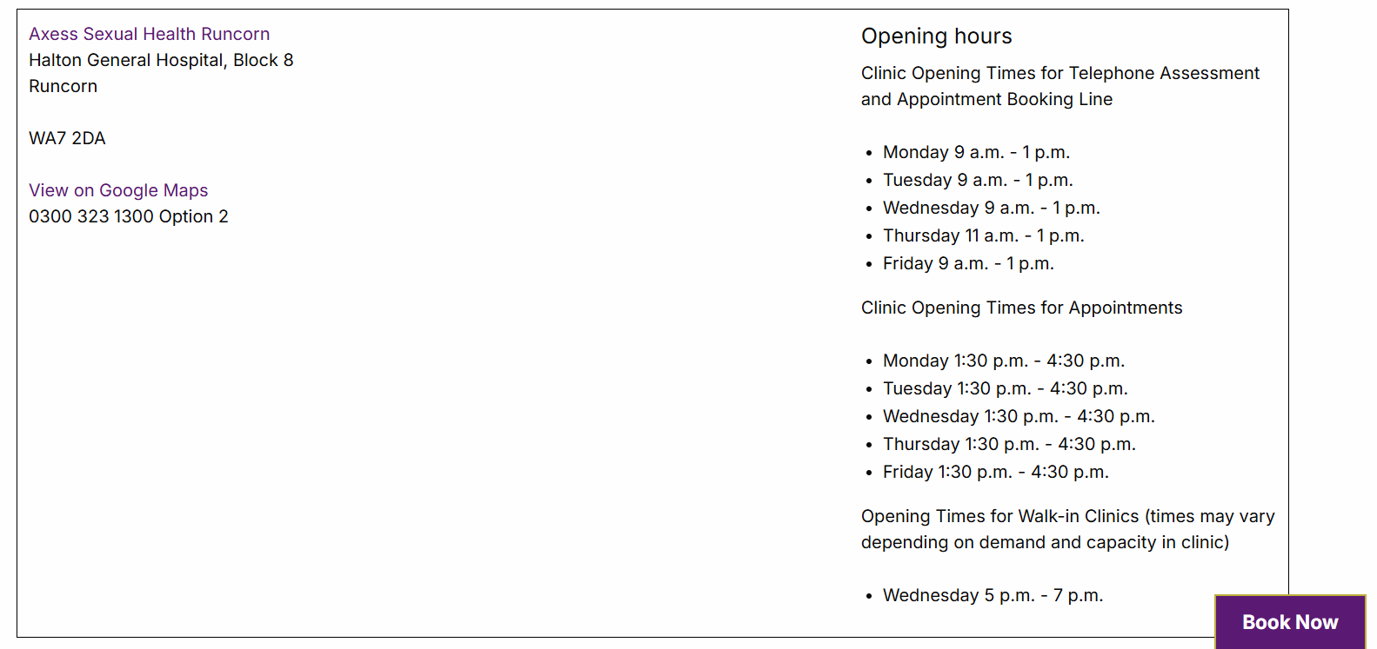
Axess Sexual Health – Halton ( Runcorn)

Slide 7
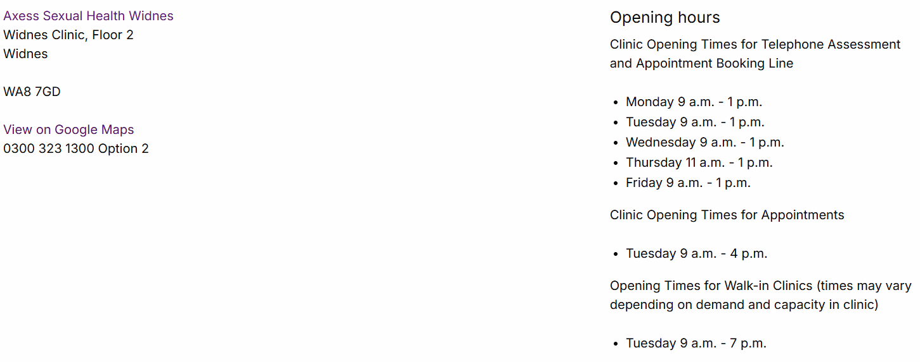
Axess Sexual Health – Halton (Widnes)

Slide 8
Axess Services Liverpool
Axess Liverpool - RLH (Linda McCartney Centre) Mount Vernon Street Liverpool L7 8XP 0300 323 1300 Option 4
Axess Sexual Health Liverpool - The Beat - Liverpool City Centre 6 David Lewis Street Liverpool L1 4AP
Axess South Liverpool - South Liverpool Treatment Centre
32 Church Rd
Liverpool
L19 2LW

Slide 9
Axess Sexual Health – Royal Liverpool Hospital (Linda McCartney Centre)
Opening Times for appointments and urgent walk-in’s (times may vary depending on demand and capacity in clinic):
Monday, 09:00-18:00
Tuesday, 09:00- 18:00
Wednesday, 09:00-18:00
Thursday, 11:00-18:00
Friday, 09:15-16:00
Saturday, 09:15-16:00
Opening Times for walk-in clinics (times may vary depending on demand and capacity in clinic):
Monday, 09:00-12:00
Tuesday, 09:00- 12:00
Wednesday, 09:00-12:00
Friday, 09:00-12:00
Opening times for telephone assessment and our appointment booking line:
Monday, 09:00-16:00
Tuesday, 09:00- 16:00
Wednesday, 09:00-16:00
Thursday, 11:00-16:00
Friday, 09:00-16:00

Slide 10
Axess Sexual Health – Liverpool City Centre (The Beat)
Opening Times for appointments:
Monday, 09:00-18:00
Tuesday, 09:00- 18:00
Wednesday, 09:00-18:00
Thursday, 11:00-18:00
Axess Young Person's clinic (19 and under):
Thursday, 3p.m. - 6 p.m.
Butterfly Clinic:
(Appointments) Monday, 1 p.m. - 6 p.m.
(Walk in) Tuesday, 1 p.m. - 4 p.m
Opening times for telephone assessment and our appointment booking line:
Monday, 09:00-16:00
Tuesday, 09:00- 16:00
Wednesday, 09:00-16:00
Thursday, 11:00-16:00
Friday, 09:00-16:00

Slide 11
Axess Sexual Health – Liverpool South (Garston)
Opening Times for appointments:
Monday, 09:00-18:00
Tuesday, 09:00- 18:00
Wednesday, 09:00-18:00
Thursday, 11:00-18:00
Friday, 09:15-16:00

Slide 12
Further Support and Information
Emergency IUDs can be arranged by calling on the day before 1pm or attending a walk-in clinic
Online smear appointments
On-line service SH:24; order for free, STI postal kits. The service includes free return post and results delivery and covers any necessary treatment or clinic appointment as required, see the link; https://sh24.org.uk/
There is an online presentation available on EC and POP, please see the following link below: https://www.youtube.com/watch?v=e0cybC_swLU
For any further information around axess sexual health, and the services available please go to their website on https://www.axess.clinic/
Psychosexual appointments & Drugs & alcohol support services - referrals only

