Slide 1
The NHS Pharmacy Contraception Service

Slide 2
Agenda
Service Description
Providing the Service
Contraception Options and Consultation
Consultation Scenarios
Top tips for delivering the Service
Service Resources

Slide 3
Service Description
Advanced service - expanded from 1st December 2023
Involves initiation, review and repeat supply of oral contraception
Pharmacies need to provide both elements of the service
Supplies via PGD
Currently consultation can only be provided by pharmacists
Suitably trained and competent pharmacy staff can provide blood pressure and BMI measurement, where appropriate
Remote provision where clinically appropriated and agreed between pharmacist and individual

Slide 4
Providing the Service
Access routes:
Pharmacy identified
Self-refer
Referred Via GP/ Sexual health clinic/ NHS 111/UEC
For the purposes of this service, a referral includes active signposting to attend the pharmacy to receive the service.

Slide 5
Providing the Service

Slide 6
Eligibility – Inclusion Criteria
Seeking to be initiated; or
Seeking a further supply of their ongoing OC:
Combined oral contraceptive (COC) – age from menarche up to and including 49 years of age
Progestogen only pill (POP) – age from menarche up to and including 54 years

Slide 7
Eligibility – Exclusion Criteria
Considered clinically unsuitable
Excluded according to the PGD protocols, including, but not limited to:
Individuals under 16 years of age and assessed as not competent using Fraser Guidelines
Individuals 16 years of age and over and assessed as lacking capacity to consent
Additional inclusion and exclusion criteria are listed in the PGDs

Slide 8
What does Initiation Include?
New to using OC
Restarting OC
Switching between OC
Bridging where a LARC is desired

Slide 9
Providing the Service
Criteria met - Supply can be made
FSRH UK Medical Eligibility Criteria for Contraceptive Use (UKMEC) calculator available to support clinical decision on choice
Local ICB formularies/restrictions should be referred to
Quantity
Initiation - quantity should not exceed 3 months
Ongoing supplies of up to 12 months duration
Supply in labelled original packs
Record any advice or signposting

Slide 10
Providing the Service
Outcomes
Criteria not met - Supply deemed not clinically appropriate
Explain
Refer
Document
reason for not supplying against a PGD
referral to an alternate service provider

Slide 12
Axess Presenter: Beth Hamer

Slide 13
Choice of Progesterone Only Pill (POP)
The progestogen-only pill (the mini-pill) is taken every single day without any breaks.
The POP is short acting and needs to be taken at roughly the same time each day. There is either a 12 hour or a 3 window in which to take it.
If a Progesterone only pill is preferred Desogestrel 75mcg tablets have up to a 12 hour window in which they can be taken.

Slide 14
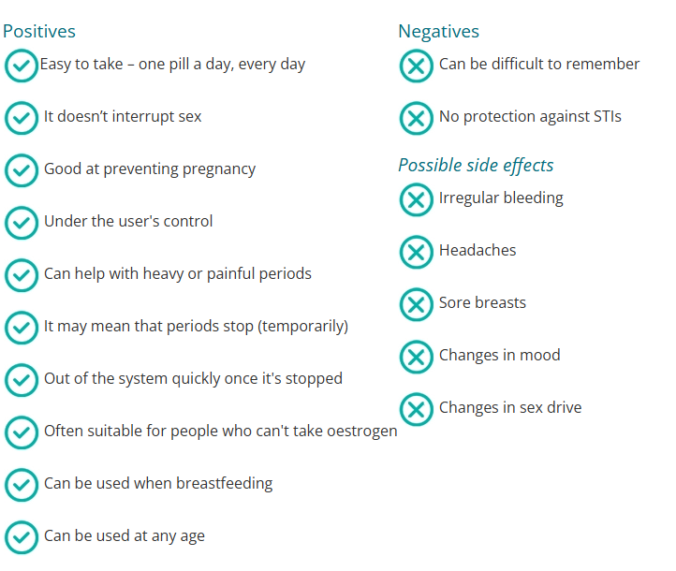
Progesterone Only Pill (POP)

Slide 15
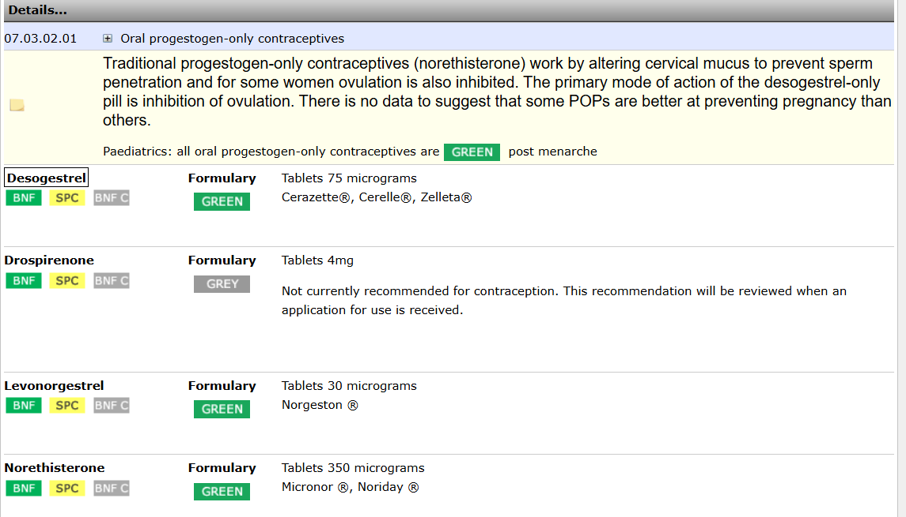
Pan Mersey POP

Slide 16
Choice of Combined Oral Contraceptive (COC)
Faculty of sexual and reproductive healthcare guidance (FSRH) does not contain information on the choice of combined pills
NICE CKS states 1st line option are monophasic preparations containing 30mcg of oestrogen, plus either norethisterone or levonorgestrel. These have a lower risk of DVT.
Choice of pill will be guided by the most cost effective product for the NHS but in line with local ICS formularies. See Pan Mersey Formulary www.panmerseyapc.nhs.uk/formulary
Consider the persons preference

Slide 17
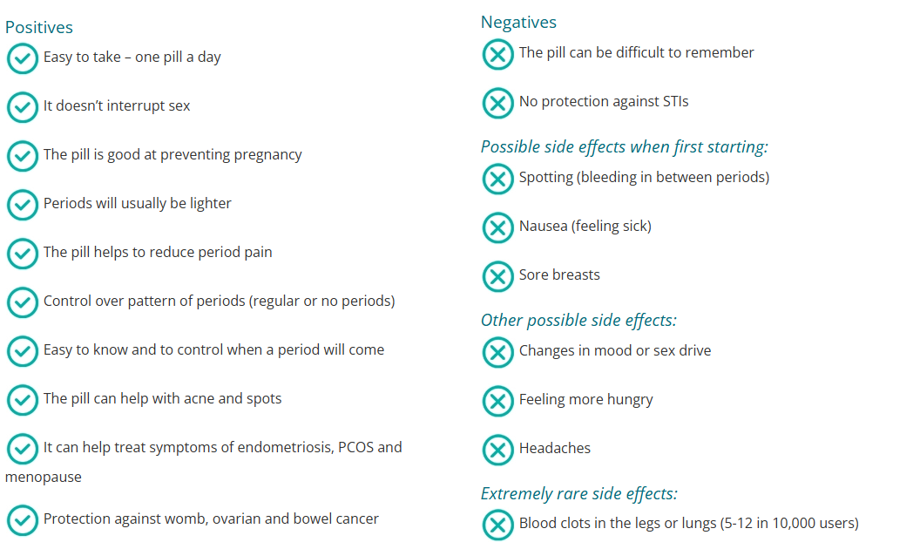
Combined Pill
The combined pill is taken every day, usually with a week off once a month (for a period)

Slide 18
Pan Mersey Combined Oral Contraception

Slide 19
Choice Of Contraception: POP v COC
This will depend on what is important to the patient
Brook and Contraceptive choices website have information for patients to help them to decide what is important to them.
If the patient is interested in Long acting contraceptives they can be signposted accordingly.
www.Brook.org.uk
www.Contraceptionchoices.org
Refer to Appendix B in the POP PGD and COC PGD to see which products can be supplied via the NHS Pharmacy Contraception Service

Slide 20
Progesterone Only Pill v Combined Oral Contraceptive
Progesterone only Pill
An option for some people who can’t tolerate the combined pill.
Irregular bleeding may bother some people.
Needs to be taken at roughly the same time of day. There is either a 3 or 12 hour “window “in which to take it.
Combined Pill
Cycle control – can take back to back and bleeding is lighter and less painful
Some people can’t use the pill because of risk of blood clots
Blood clots in the legs or lungs is a very rare side-effect (5-12 in 10,000 users)

Slide 21
Side Effects from Previous Pill
Progestogen side effect Combined Pill
Scanty menses, dry vagina, breat tenderness, dull type of headache, appetite increase, weight gain, premenstrual depression, leg cramps, softening of ligaments, acne, greasy hear, low mood, low libido especially if associated with low mood. (But it can also sometimes help with low libido)
Try changing to a less andronergic progestogen or higher oestrogen pill for example Ethinylestradiol 30mcg/desogestrel 150mcg. Gedarel 30/150
If this is still not tolerated Ethinylestradiol 30mcg/ drospirenone 3mg brands include Lucette or Yacella
Oestrogen side effects
Menorrhagia, breast fullness, migraine type headaches, fluid retention, tiredness, irritability, nausea.
Try changing to a lower oestrogen or higher progestogen pill or pill with some andronergic activity
Check local formulary

Slide 23
Which Combined Contraception Regime?

Slide 24
How much Oestrogen?
20 µg versus >20 µg oestrogen combined oral contraceptives for contraception
a systematic review was undertaken and found that:
no differences were found in contraceptive effectiveness for 20 µg versus >20 µg oestrogen combined oral contraceptives.
compared to the higher-oestrogen pills, several COCs containing 20 µg ethinyl estradiol (EE) resulted in higher rates of early trial discontinuation (overall and due to adverse events such as irregular bleeding) as well as increased risk of bleeding disturbances
cycle control may be better with COCs containing 30-35 µg EE compared with those containing 20 µg.
Gallo MF, Nanda K, Grimes DA, Lopez LM, Schulz KF. 20 µg versus > 20 µg estrogen combined oral contraceptives for con- traception. Cochrane Database of Systematic Reviews 2013, Issue 8. Art. No.: CD003989. DOI: 10.1002/14651858.C D003989

Slide 25
20-30 mins for COC initiation
About 10 mins for ongoing POP consultations
15-20 minutes for POP provisions
(no clinical measurements)
15 mins for COC ongoing supply
The consultation

Slide 26
Contraception Consultation
What a good Contraception consultation looks like
Ensure you document the full consultation, patients priorities that have influenced choice, outcome, advice, leaflets given and safety netting advice.
Axess Guide to selecting contraception based on patient preference or health conditions

Slide 27
Thinking about safeguarding
Who is with you today?
Don’t make assumptions!
Did anyone bring you to the pharmacy today?
Where are they now?
Consider speaking to the person using the service alone initially to check if they want someone else who brought them present in the consultation

Slide 28
Safety Netting
Useful to document from a medicolegal perspective the full consultation, outcome, advice and leaflets given etc
Return if problems occur and phone NHS111 if the pharmacy is closed
www.NHS.UK for further information
Combined pill https://www.nhs.uk/conditions/contraception/combined-contraceptive-pill/
Progestogen only pill https://www.nhs.uk/conditions/contraception/the-pill-progestogen-only/
Pills do not protect against STIs
If pills are missed, come and check if you need emergency contraception or phone NHS111 if the pharmacy is closed
Consider alternative methods of contraception

Slide 29
Consultation Scenarios

Slide 30
Scenario 1
A patient presents asking for a repeat of her Levest COC. They do not take any other medication, have no allergies, have no side effects or problems associated with Levest. The patient is not pregnant or breastfeeding. They have taken the last pack of Levest correctly, and are due to resume their next cycle tomorrow. You complete the paperwork and there are no exclusion criteria met with regards to health or family history. However, when completing the blood pressure element of the service, her reading is 144/93. This is repeated twice more, with readings of 143/94 and 145/92. The patient is becoming impatient as they have to go to collect their child from school.
What would you do?

Slide 31
Scenario 1 – Discussion Points
A PGD exclusion criteria is a blood pressure greater than 140/90mmHg or controlled hypertension.
In the Faculty of Sexual and Reproductive Healthcare UK Medical eligibility (FSRH UK MEC) for contraception use, a systolic blood pressure of 140–159 mmHg or diastolic blood pressure of 90–99 mmHg, is category three condition. This means that the risks outweigh benefits for this method of contraception.
The patient is rushing between appointments, so it is possible that after relaxing if she took her blood pressure at home it would be lower. People can use self-reported blood pressure readings for this service. However, the patient wants to get a supply of contraceptive pills now.
An option open to you is to provide a progestogen only pill, whilst her blood pressure is investigated and if necessary treated. Once it is back in range, she can resume her combined hormonal contraception. As this would be an initiation you can only provide three months' supply of this pill.
Desogestrel has a 12-hour window in which it can be taken so this is an obvious first choice of progestogen only pill, compared to traditional progestogen only pills which only have a three-hour window in which they can be taken.
Ensure that the patient's blood pressure is investigated
It is important that the patient’s blood pressure is investigated further.
You could offer the hypertension case finding service, including if necessary 24-hour ambulatory blood pressure monitoring another day.
If the patient does not want to do this then discuss the importance of seeing her GP in the next three weeks.

Slide 32
Scenario 2
A 16 year old patient attends the pharmacy. She has recently started having consensual intercourse with her boyfriend and is currently using condoms, but is thinking about starting hormonal contraception. She doesn’t know a lot about the options available to her and would therefore like some advice so she can make an informed decision. How would you proceed?

Slide 33
Scenario 2 – Discussion Points
Phrases to start the discussion:
Do you have any thoughts on the type of contraceptive pill that you would like?
Would you like me to tell you about the two main types of oral contraception available?
Long-acting reversible contraceptives for example the injection, implant and coil are the most effective forms of contraception, would you like to talk about these today?
How are you getting on with your contraceptive pills?
Do you have any concerns or problems with your contraceptive pill?
Consideration of safeguarding concerns.

Slide 34
Scenario 3
A patient returns six weeks after initiating desogestrel as she is experiencing irregular /breakthrough bleeding which is getting no better. She would like to know what her options are. Assume no exclusion criteria are met within any of the PCS PGDs. How would you proceed?

Slide 35
Scenario 3 – Discussion Points
It is worth stating at initial consultations that if someone doesn’t get on with a particular pill it can be changed. This can either be done at three months or earlier if the person has concerns.
Good practice to exclude STI, pregnancy, drug interactions, compliance and up-to-date smears
Irregular bleeding is unpredictable and a commonly cited as a reason for discontinuation of POP.
‌Use of CHC can improve irregular bleeding. Advise that breakthrough bleeding is common in the first 3 months. If this remains a problem, you could then look to increase oestrogen or change to progestogen with better cycle control. Options include 30mcg EE/75mcg GSD (e.g. Katya or Millinette) * 35mcg EE/250mcg NGT (e.g. Cilique or Lizinna) If BTB starts after 3 months refer to GP or Axess.
If switching to a CHC - as this an initiation of the contraceptive pill three months’ supply should be given.

Slide 36
Scenario 4
A patient returns to the pharmacy a month after starting Rigevidon as she is complaining of worsening acne. There has been no changes to her health or circumstances otherwise, and she still meets all inclusion criteria for the PCS PGDs with no exclusion criteria met for either. How could you proceed?

Slide 37
Scenario 4 – Discussion Points
It is worth stating at initial consultations that if someone doesn’t get on with a particular pill it can be changed. This can either be done at three months or earlier if the person has concerns.
‌Use of CHC can improve acne according to FSRH guidance. FSRH Guideline (January 2019) Combined Hormonal Contraception. BMJ Sexual & Reproductive Health [Internet]. 2019 Jan;45(Suppl 1):1–93. Available from: https://srh.bmj.com/content/45/Suppl_1/1
If a woman is experiencing acne on a progestogen dominant pill such as Rigevidon, it is worth changing to a less progestogenic pill or a more oestrogen dominant pill.
Options include: * 150mcg DSG/ 30mcg EE (e.g. Cimizt, Gedarel or Marvelon) * 0.03mg EE/ 3mg DRSP (e.g. Yacella, Yiznell, Dretine) * 250mcg NGT/ 35mcg EE (e.g. Cilique or Lizinna)
As this an initiation of the contraceptive pill three months’ supply should be given.

Slide 38
Scenario 5
A patient presents for EHC in your pharmacy. You recognise her from a previous EHC consultation a few weeks back, so decide to discuss future contraception with the patient. They are flustered as they remember you too and find this all very embarrassing. They aren’t really sure whether they want oral contraception or not. They also point blank refuse to attend the Axess clinic for a copper coil insertion. How would you proceed?

Slide 39
Scenario 5 – Discussion Points
It is important that you show a non-judgemental approach.
A discussion should be had around the type of EHC provided and when OC can be taken afterwards.
If she has ulipristal acetate, then she needs to wait five days before starting hormonal contraception. Given her being undecided on OC, it is reasonable to find another time for her to come in and discuss ongoing contraception. Maybe you could direct her to a patient resource, for example the contraceptive choices website or Brook to have consider this further so that she has time to think before she comes back, if she would like to.
If she has levonorgestrel, emergency contraception then she could start hormonal contraception straightaway, however this is less effective closer to ovulation. For more information see Emergency Contraception [Internet]. Fsrh.org. 2024. Available from: https://www.fsrh.org/Public/Public/Standards-and-Guidance/Emergency-Contraception.aspx
Whilst the copper intrauterine device is gold standard in terms of efficacy, and would provide ongoing contraception, the patient is certain that she does not want this.

Slide 40
Scenario 6
A patient wishes to restart oral contraception after the birth of her daughter six months ago. They are currently breastfeeding her, but have recently reduced the amount of breastfeeding so their husband can bottle feed too. The patient has been using condoms with her husband, but is worried about their reliability as a long-term option. Their preference is for a pill that does not cause irregular bleeding. Their BMI is 24.8, BP is 110/78 and there are no other contraindications for supply on either PGD. How would you proceed?

Slide 41
Scenario 6 – Discussion Points
The FSRH advises that people who are breastfeeding should be informed that there is currently limited evidence regarding the effects of combined hormonal contraceptive use on breastfeeding. However, the better-quality studies of early initiation of CHC found no adverse effects on either breastfeeding performance (duration of breastfeeding, exclusivity and timing of initiation of supplemental feeding) or on infant outcomes (growth, health and development).
If the baby was younger people who are breastfeeding should wait until 6 weeks after childbirth before initiating a combined hormonal contraception method. Breastfeeding and less than six weeks post-partum is a PGD exclusion criteria.
The patient can be assured that progestogen only pills have no impact on breast feeding.
You need to think about whether she may already be pregnant:
People may be advised that, if they are less than 6 months postpartum, amenorrhoeic and fully breastfeeding, the lactational amenorrhoea method (LAM) is a 98% effective method of contraception.
However, the FRSH state that people using LAM should be advised that the risk of pregnancy is increased if the frequency of breastfeeding decreases (e.g. through stopping night feeds, starting or increasing supplementary feeding, use of dummies/pacifiers, expressing milk), when menstruation returns or when more than 6 months after childbirth. As this describes the patient’s current situation another method of contraception is needed to protect her now.

Slide 42
Scenario 6 – Discussion Points
It would be sensible to check that the patient could not already be pregnant now.
If the baby was younger you would need to think about the patient’s post pregnancy thromboembolism risk.
A PGD exclusion criteria is not breastfeeding and less than 6 weeks post-partum with other risk factors for venous thromboembolism (VTE). In this case a progestogen only pill could be used. The FSRH states that the earliest time you can start CHC is at 3 weeks post-partum but only if not breastfeeding and NO other risk factors for VTE

Slide 43
Top Tips from Pharmacies providing the Service

Slide 44
Top Tips – Providing the Service
On your table review the Top Tips Guide and discuss what you are doing in your pharmacy.

Slide 45
Getting started
Print all posters and advertising materials provided
Leaflets in bags - use translated materials
Posters in pharmacy waiting area
Social media
Add to pharmacy online profiles
Poster in local surgeries/sexual health clinic
Add a message onto your phone call holding message
Be aware of which other pharmacies in the area can provide the service
Work out when your pharmacy can provide the service – Will it be
walk in or appointment?

Slide 46
Identifying Potential Patients
Run a PMR search for any patients who have received Oral Contraception from your pharmacy in the last 6 months
Highlight service to any patients collecting prescriptions for oral contraception
Highlight service to any patients purchasing or accessing EHC

Slide 47
Engage General Practices & sexual health clinics
General practice clinical pharmacists / PCN pharmacists / Sexual health leads
Follow up emails to clarify any issues
Follow up phone calls with practice managers and clinical pharmacists to provide mentorship and support
Utilised links developed as PCN community pharmacist Lead

Slide 48
Making it work in practice
Think about:
An appointment system and how to offer both appointments and walk-ins?
Manage bookings in your diaries to ensure staff aware of availability
Clear process on what information to capture
Support staff to measure weight, height and BP when needed.
The use of remote consultations
Most consultations will be continuations rather than initiations
Encourage patients to access at least two weeks before they run out
How do you help urgent need? Signposting?
How do you manage pharmacist absence?

Slide 49
Making it work in practice
Think about:
An appointment system and how to offer both appointments and walk-ins?
Manage bookings in your diaries to ensure staff aware of availability
Clear process on what information to capture
Support staff to measure weight, height and BP when needed.
The use of remote consultations
Most consultations will be continuations rather than initiations
Encourage patients to access at least two weeks before they run out
How do you help urgent need? Signposting?
How do you manage pharmacist absence?

Slide 50
Final Points for Consideration

Slide 51
Guidance and resources
Pharmacy team
Use a whole pharmacy team approach to promotion and recruitment
Community Pharmacy England Briefing 033/23: Briefing for pharmacy teams – the Pharmacy Contraception Advanced Service
Pharmacy staff providing blood pressure and BMI measurements must be appropriately trained and competent

Slide 52
Axess Sexual Health Sites
See separate set of slides

Slide 53
Further information and resources
cpe.org.uk/PCS
FAQs: cpe.org.uk/PCSfaqs
www.Brook.org.uk
www.Contraceptionchoices.org
FSRH UMEC: UK Medical Eligibility Criteria for Contraceptive Use (UKMEC) | FSRH
Axess COC Decision making Algorithm
Lets talk about it Contraception: Lets talk about it Contraception
Good luck with the service!

Slide 54
Questions

