Slide 1
Pharmacy First Top Tips Meet the gateway point When to get the Pharmacist

Slide 2
Sore Throat: Over 5 years old
You only need a MINIMUM of TWO of the following (FEVER PAIN SCORE)
Coming to your pharmacy within 3 days after onset of symptoms
No cough or cold symptoms
Fever (temperature over 38°C)
Purulence (white spots/puss)
Severely Inflamed tonsils
Product Led Requests: Strepsils, Difflam spray, throat lozenges & pain relief.

Slide 3
Insect Bites: Over 1 year old
To achieve the gateway point, the patient must have an insect bite/sting:
Presented more than 2 days after bite/sting (no tick).
Within UK – This does not include bites whilst on holiday abroad.
And meet the following:
Redness & swelling of skin that is spreading.
Discharge from bite/sting.
Product Led Requests: Antihstamine cream/tablets, hydrocortisone creams

Slide 4
Otitis Media: 1-17 years
Includes:
Any patient that presents with earache.
Excludes:
Pregnant patients
Patients that have recurrent earache.
Product Led Requests: Calpol, Eardrops e.g EarCalm

Slide 5
UTI: Women 16-64 years
Any patient presenting with UTI symptoms meets the gateway criteria:
Urgency.
Frequency.
Having to go at night-time.
Cloudy urine.
Stinging when passing urine.
Pubic pain.
Product Led Requests: Cystopurin sachets, Cymalon, Potassium Citrate liq, Cranberry products, Feminine products e.g. Thrush treatment, urine sample bottles?

Slide 6
Sinusitis: Over 12 years, symptoms > 10 days
Nose runny or blocked for at least 10 days AND ONE (or more) of:
Facial pain / pressure / headache.
Reduced / loss of the sense of smell (in adults)
Cough during the day or at night (in children)
Product Led Requests: decongestants, steroid nasal sprays, nasal rinse

Slide 7
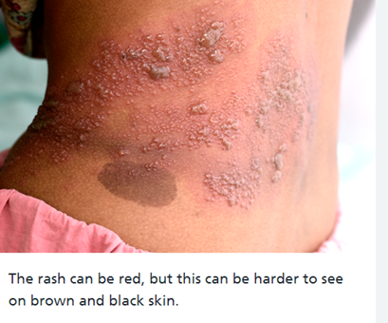
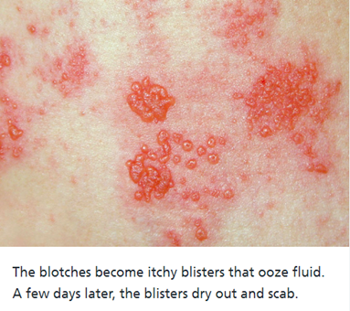
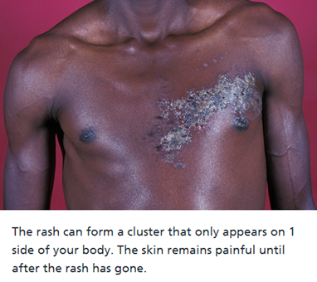
Shingles: Over 18 years
Rash appears within 2-3 days after onset of pain and fever, or headache may develop
Red spots on a pink-red background which turn quickly into small fluid-filled blisters
On one side of the body

Slide 8
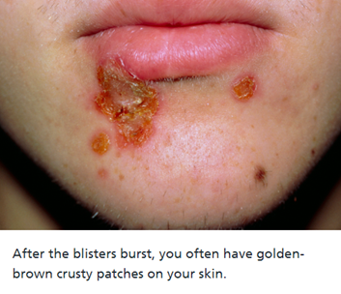
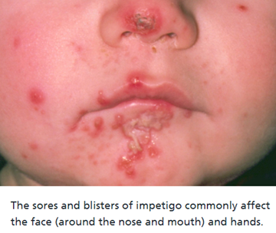
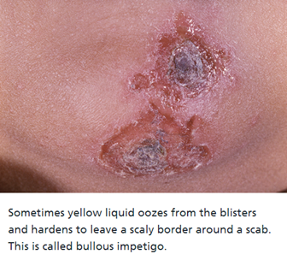
Impetigo > 1 year
Lesion/crusty yellow/gradually thickens
Can be anywhere on body but most common face, limbs, bends/folds
Don’t always present with other symptoms, maybe itchy

