Slide 1
Flu champion slides
2024/25 season
Provided by: NHSE NW PH Commissioning Team (Screening and Immunisation Team)
Cheshire, Merseyside, Lancashire and South Cumbria england.nwsit@nhs.net
Notes:
Standard title slide

Slide 2
Objectives
Understand flu and the importance of flu vaccinations
Promote flu vaccinations
Signpost eligible people to where they can get their vaccination
Have the flu vaccination if you are eligible
Notes:
Plain slide with subhead and bullets

Slide 3
Symptoms of Flu
People sometimes think flu is a bad cold, but having flu can often be much worse than a cold and you may need to take time off work and stay in bed for a few days
Common symptoms include:
sudden onset of fever, chills, headache, muscle and joint pain and extreme fatigue
dry cough, sore throat and stuffy nose
in young children, symptoms such as diarrhoea and vomiting may be seen
Some people are more vulnerable to the flu virus. For them, it can increase the risk of developing more serious illnesses such as bronchitis and pneumonia or can make existing conditions worse. In the worst cases, flu can result in a stay in hospital, or even death

Slide 5
Who is affected?
Anyone can catch flu, but it can affect some more than others and risk serious illness or death in:
newborn babies
elderly people
pregnant women
people with underlying diseases/health problems
people with impaired immunity

Slide 6
How do you get flu?
Flu is passed from person to person by droplets created when someone with the infection sneezes or coughs
You can also catch it by touching a surface where the virus has been left
People with mild or no symptoms can still infect others
Flu spreads easily when people are gathered together indoors during the winter months

Slide 7
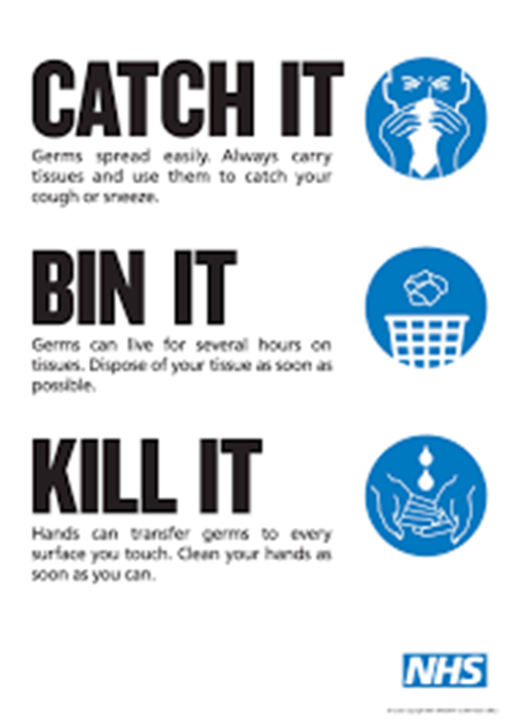
How can flu be prevented?
Have the flu vaccination if you are eligible

Slide 8
Handwashing
Handwashing is one of the easiest ways to protect yourself and others from illnesses such as flu, COVID-19 and food poisoning
Washing your hands should take as long as it takes to sing “Happy Birthday” twice – around 20 seconds
You should routinely wash your hands frequently

Slide 9
The flu vaccination
The flu vaccine stimulates your body's immune system to make antibodies to attack the flu virus
Antibodies are proteins that recognise and fight off germs, such as viruses, that have invaded your blood
If you're exposed to the flu virus after you've had the flu vaccine, your immune system will recognise the virus and immediately produce antibodies to fight it
It may take 7 to 14 days for your immunity to build up fully after you have had the flu vaccination

Slide 10
Types of flu vaccination
There are several different flu vaccinations available each year
Some vaccines are less effective in certain people, for example the elderly. It is therefore important that each group is offered the most appropriate vaccine
Vaccines are recommended for different groups based on the evidence regarding quality and effectiveness of the vaccines
Most years, one or two strains of type A flu circulate as well as type B. The flu vaccines contain 2 type A strains and 2 type B strains

Slide 11
Who can have the flu vaccination
All children aged 2 and 3 years old
All school aged children from reception to year 11
People aged 65 years and over
Pregnant women
People with a learning disability
People who are very overweight with a body mass index (BMI) of over 40

Slide 12
Who can have the flu vaccination (continued)
Chronic (long-term) respiratory diseases, such as asthma, chronic obstructive pulmonary disease (COPD) or bronchitis
Chronic heart disease, such as heart failure
Chronic kidney disease
Chronic liver disease, such as hepatitis
Chronic neurological conditions, such as Parkinson’s disease
Diabetes
People with impaired immunity due to diseases or treatments

Slide 13
Who can have the flu vaccination (continued)
People with lowered immunity due to diseases or treatments e.g. cancer treatment
People living in a long-stay residential care homes or nursing homes
Carers
Front line health, hospice and social care workers with patient contact

Slide 14
Flu can be serious for pregnant women and babies
A pregnant woman who catches flu is more likely to need admission to hospital than a woman who isn’t pregnant
Flu can be serious for unborn and newborn babies
Flu can lead to premature birth, low birth weight, still birth or even death in the first few weeks of life

Slide 15
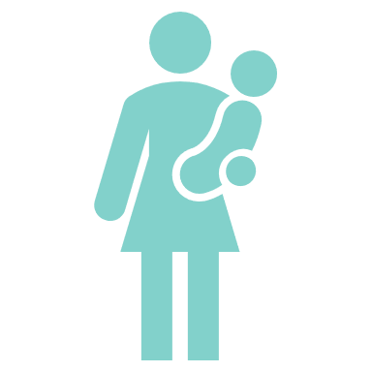
Benefits to the baby of pregnant women being vaccinated
Flu vaccination during pregnancy reduces the chance of the pregnant woman catching flu and passing the virus to the baby
The baby will also develop some immunity to flu as antibodies are passed from the woman to her baby through the placenta
This will protect the baby for its first few months of life
The mother will continue to be protected throughout the flu season, and so be less likely to pass flu onto the newborn baby

Slide 16
Timing
The start of the programme for most adults has moved to the beginning of October. Most flu vaccinations should be completed by the end of November, closer to the time that the flu season commonly starts
It is preferable to vaccinate people closer to the time when the flu virus is likely to circulate (which typically peaks in December or January), as this will provide the best protection during the highest risk period
A small number of adults may be offered the flu vaccination in September. In exceptional circumstances, there may be a clinical decision to bring forward vaccination to September
Pregnant women can be offered the flu vaccination from the beginning of September
It's always worth getting vaccinated, even if there have already been outbreaks of flu

Slide 17
Flu fact 1 – side effects
It’s impossible to get flu from the flu vaccine because the adult vaccine doesn’t contain live viruses, and the children’s nasal spray vaccine has been weakened to prevent it from causing flu
Those having an injected flu vaccine may get a sore arm at the site of the injection, a low-grade fever and aching muscles for a day or 2 after the vaccination
Children are usually offered the flu vaccination in a nasal spray. This may cause a runny or blocked nose, headache, general tiredness and some loss of appetite. However, these are much milder than developing flu or complications associated with flu. Serious side-effects are uncommon

Slide 18
Flu fact 2 - effectiveness
Some people confuse having a cold with having flu. Lots of infections are around in winter, and some have similar symptoms to flu
Not everyone will develop immunity from the vaccine, so despite having the flu vaccination some people will still be at risk and may catch flu
This makes it really important that as many eligible people as possible are vaccinated to reduce the spread of the disease and protect those who remain at risk

Slide 19
Flu fact 3 - frequency
Eligible people need to have the flu vaccination every year
The viruses that cause flu can change, so you need a vaccination that matches the new viruses each year
The vaccine usually provides protection for the duration of that year's flu season

Slide 20
Flu fact 4 - allergies
Almost everybody can have the flu vaccine, but people should not be vaccinated if they have ever had a serious allergy to the vaccine, or any of its ingredients
Most people who are allergic to eggs can have the flu vaccination. They should discuss it with a healthcare professional

Slide 21
Flu fact 5 – protection
The flu vaccines used in the national NHS programme have a good safety record
The vaccines are thoroughly tested
Millions of doses are given every year

Slide 22
Flu fact 6 – porcine gelatine
The children’s nasal spray contains gelatine that comes from pork as one of its additives as it was found to be the most effective stabiliser
The nasal spray is the most effective vaccine for children
Some people may decline the nasal spray vaccine due to the porcine gelatine content
Children should have the injectable vaccine as an alternative if they decline the nasal spray due to the porcine gelatine content
https://www.gov.uk/government/publications/childrens-flu-vaccination-programme-nasal-flu-vaccine-and-porcine-gelatine

Slide 23
How to get the flu vaccination
GP practice/PCNs
Community pharmacies
School vaccination teams
Midwives
Employers
Outreach services e.g. Substance misuse treatment services and HIV sexual health services

Slide 24
How you can help
Promote the flu vaccine
Talk to people about flu vaccinations
Provide accurate facts about flu and flu vaccinations
Tell people where to get the flu vaccine
Have the flu vaccination if you are eligible
Wash your hands regularly
Catch it. Bin it. Kill it.

Slide 25
Resources information
Health Publications – leaflets and posters
www.healthpublications.gov.uk
Campaign Resource Centre – leaflets, posters and social media resources
https://campaignresources.phe.gov.uk/resources/

Slide 26
End slide

