Slide 1
Knowsley Community Pharmacy
Blood Pressure @home Service

Slide 2
Training Overview
Background to the pilot
Outline of the service and service Materials
Tips for delivery of the Service
Referral Process
Consultation recording via PharmOutcomes
Service Outcomes

Slide 3
Background
This is a Knowsley only service at present. Pharmacies have been commissioned to supply 1,600 BP monitors which have been allocated for the service
Nationally the project has been implemented via GP practices
The BP@home, supply of blood pressure monitors, supports the management of existing hypertensive patients in Primary care
It is a pharmacist only service and relies on a referral from a Knowsley GP practice. BP machines CAN NOT be given out to patients who have not been referred
Knowsley GP practices are piloting the supply via community pharmacy. If the pilot is successful we would look to increase the number of blood pressure monitors available and expand to other CCG areas

Slide 4
Outline of the Service
GP Referral received via PharmOutcomes – contact the patient to arrange an appointment
1st Consultation
Check patient identity and gain patient consent for the service
Explain to the patient how to take a blood pressure reading and check the cuff size
Provide the patient with the BP machine (for patient to keep), appropriately sized cuff and patient diary.
Explain that they are required to take and record a series of blood pressure readings across a 4-day period, (2 in the morning and 2 in the evening) and notify the pharmacist of these readings within 1 week, ideally in person or over the telephone
Explain they need to make an appointment to see their GP if they have 2 consecutive readings = or > than 170mmHg systolic or = or > than 115mmHg diastolic either number
Provide advice regarding action to be taken if irregular heart beat flags

Slide 5
Outline of the Service -contd
Second Consultation
The pharmacist will calculate the average BP reading for the 4-day period, enter the information onto PharmOutcomes and provide the patient with relevant advice
The pharmacist will select the GP notification based on the average BP reading and send to the GP practice and the patient will be followed up by their GP practice as clinically appropriate
There is a payment of £20 per patient
The pharmacy will not be paid if the referral is rejected or the patient is lost to follow up.

Slide 6
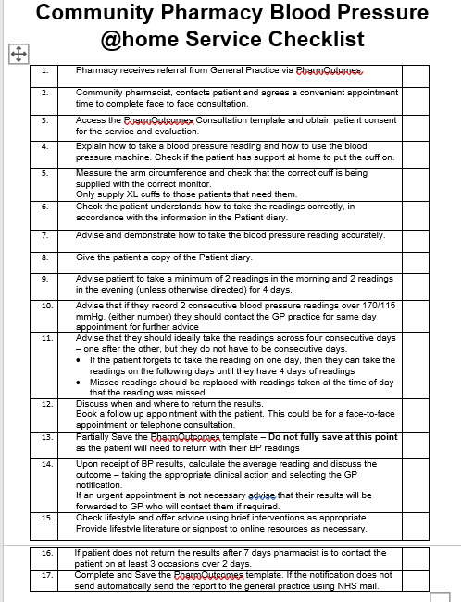
Service Materials and happy-hearts website
Community Pharmacy Blood Pressure@home Service Checklist outlines the steps to be taken
Consultation recording is via the PharmOutcomes template.
When you give the BP machine to the patient – “Partially save the consultation” as you will need to record the outcome of the consultation in a few days time, calculate the average BP reading and send the GP a notification. Once the second consultation has been completed the consultation can be fully saved.
The PharmOutcomes template contains
The 4 day calculator which is to be used to calculate the average reading
Blood pressure thresholds
Copy of the patient diary
Service level agreement
Print off copies of the patient materials in a service delivery folder.

Slide 7
Service Materials and happy-hearts website
Materials can also be found in the professional section of the happy hearts website https://www.happy-hearts.co.uk/professionals/blood-pressure/professional-resources-and-materials
• BP record sheet auto calculator v7 – also accessible via PharmOutcomes template
• Cuff guidance
• Pharmacy checklist
• Key lifestyle messages
• Patient diary – also accessible via PharmOutcomes template
• Useful links patient resources
• Checking BP at home poster
• How to measure blood pressure at home – video

Slide 8
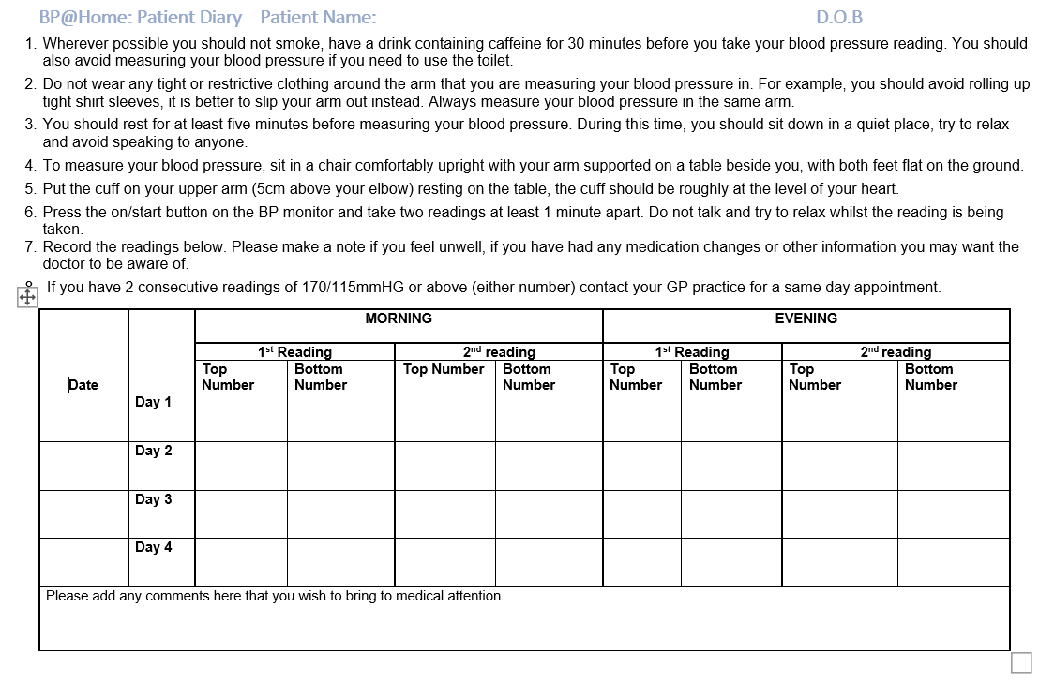

Slide 9
What if a patient misses readings?
Advise the patient they should ideally take the readings across 4 consecutive days
If they forget to take the readings on one day - then they can take the readings on the following day, until they have 4 days readings
If the patient forgets to take a set of readings e.g. 2 evening readings are missed. Replace the missed evening readings with evening readings from the next day. They are not to use morning readings

Slide 10
What if an irregular heart beat flags on the machine?
Advise the patient to contact their GP practice for a same day appointment - so their heart rhythm can be checked
If the patient has not contacted their GP practice and advises you of an irregular heart beat when providing their BP readings
Tick the irregular heart beat box on the PharmOutcomes template – this will populate on the GP notification
Select the GP notification colour based on the average BP reading
Contact the GP practice for a same day appointment

Slide 11
Tips to successfully delivering the service
• Refer to the Pharmacy Checklist - it summarises the process
• Consent includes the provision of the service and evaluation
Any evaluation will be anonymized data
•Measure for the correct cuff size – See cuff guidance
It is really important for the accuracy of the reading that the cuff is the correct size for the patient
If the standard cuff is too large. Reject the referral, adding cuff too large, to comments box and advise the patient to contact the GP practice for a non urgent appointment.
• Show the patient how to take a BP reading and check that the patient understands.
Let them have a trial run to gain confidence.
• Check to see if they have anyone to help them put the cuff on – discuss who could help
• Give the patient the Patient diary
as a reminder of how to take the readings and to use to record the readings on

Slide 12
Tips to successfully delivering the service
• Key advice for the patient
Explain what to do if they miss a reading
Explain what to do if the machine flags an irregular heart beat
Explain they need to make an appointment to see their GP if they have 2 consecutive readings = or > than 170mmHg systolic or = or > than 115mmHg diastolic either number
• Agree a date and time for the second consultation – this can be face to face or telephone
• Use the resources in the PharmOutcomes template and on the happy-hearts website
Pharmacist will need to select the notification based on the service BP thresholds
• Check at least weekly how many BP machines and XL cuffs you have
• Remember to order XL cuffs (if needed) when ordering extra machines.
• If the notification doesn’t send automatically via PharmOutcomes send to GP practice in hard copy or via NHSmail
• When the LPC confirms the referral mechanism is in place. Let your GP practice know you are ready to receive referrals
Notes:
There is only funding to deliver XL cuffs at the same time as the BP machines.

Slide 13
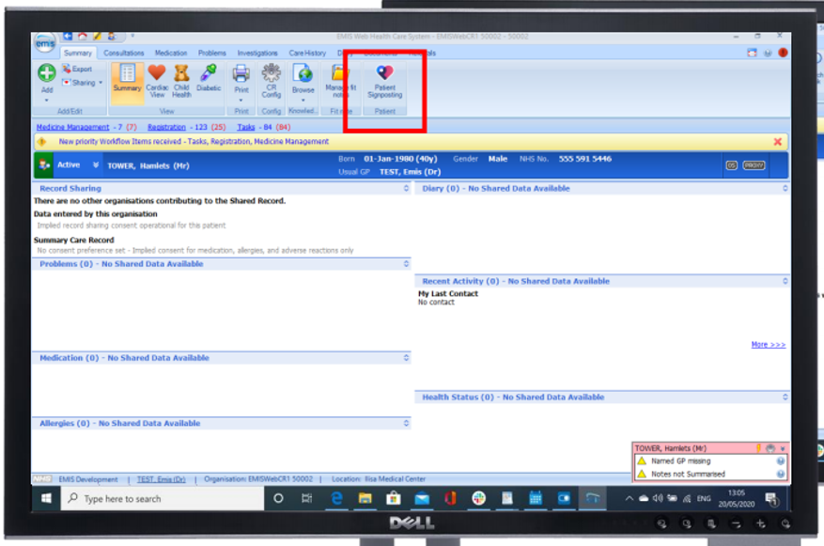
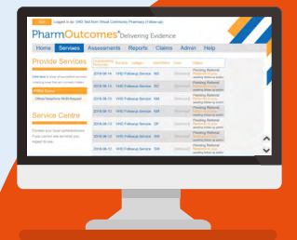
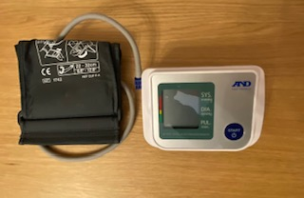
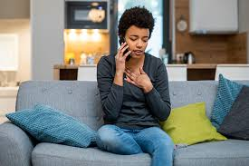
So how does this work?
1. Practice contact the patient to gain consent to refer to pharmacy
2. GP practice create a referral using the patient access button
3. The pharmacy receives the referral and calls the patient
4. The patient has a face to face appointment with the pharmacist and collects their BP machine
5. The patient provides their BP readings and the pharmacy notifies the GP practice

Slide 14
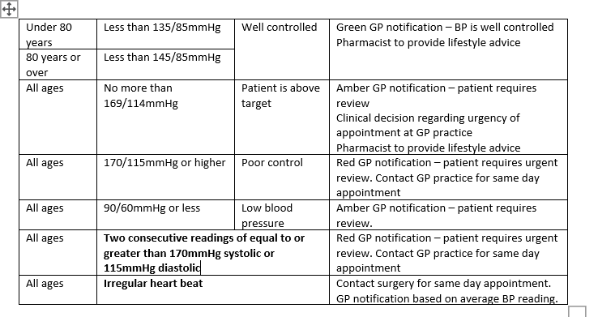
At Home BP targets
Select the appropriate BP notification based on the age of the patient and value of the systolic and diastolic readings according to the @home BP targets
Notes:
These are specific to the BP@home service and are aligned to NICE guidance

Slide 15
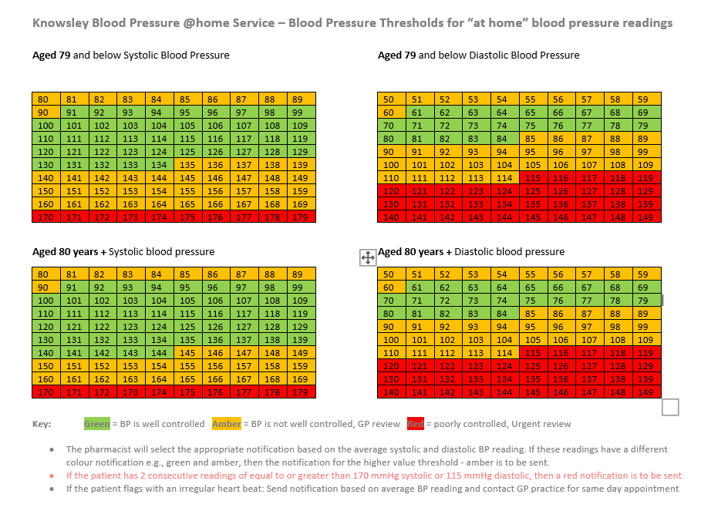
Blood Pressure @home BP Threshold Summary

Slide 16
Patient examples
Patient is 65 years old with an average BP reading of 132/90 mmHg – they fall under the amber above target category because the diastolic reading is above the well controlled threshold
Patient is 80 years old with an average BP reading of 142/84 mmHg – they fall under the green well controlled category because they are meeting the targets for their age group
Patient is 43 years old with an average BP reading of 170/115 mmHg – they fall under the red poorly controlled category and require a same day appointment to be made by the pharmacist with the GP practice.
Notes:
These are specific to the BP@home service and are aligned to NICE guidance

Slide 17
Patient Examples
Patient is 72 years old with an average BP reading of 135/84 mmHg. Irregular heart beat flagged when taking the readings and they haven’t contacted the GP practice. Send amber notification based on average BP and contact GP practice for same day appointment.
Patient is 85 years old with an average BP of 90/65 mmHg – they fall under the amber target category because their BP is low
Patient is 55 years old with an average BP reading of 168/113 mm/Hg, but 2 consecutive readings of=> 170/115mmHg either reading – they fall under the red poorly controlled category and require a same day appointment to be made by the pharmacist with the GP practice.
Notes:
These are specific to the BP@home service and are aligned to NICE guidance

Slide 18
Service Outcomes
1. Accept / Reject feature - not paid for rejections
If the pharmacy is unable to contact the patient the pharmacy can reject the referral, a notification will be sent to the GP practice.
2. Patient attends - paid
The pharmacist calculates the average BP reading, and clicks on the appropriate notification.
3. Patient unable to take BP reading - paid
Consider if further support could be provided to enable readings to be taken. If not mark as “patient unable to take BP readings”
4. Patient self-referred to GP practice - consecutive high readings or irregular heart beat – paid
Patient contacted the GP practice for an urgent appointment due to 2 consecutive readings > 170mmHg/115mmHG either reading
5. Lost to follow up – not paid
If the patient does not present or provide the BP readings within 7 days of the initial consultation the pharmacist is to contact the patient to obtain the BP readings. A minimum of three attempts over 2 days should be made to contact the patient.
If the pharmacist is unable to contact the patient to obtain the BP readings. Mark the follow-up consultation as “patient did not present with BP readings”. The consultation record is considered as incomplete and ineligible for payment.
Notes:
Patients unable to take their BP readings will be a criteria that will be reviewed by the Commissioner for future commissioning

Slide 19
Equipment Supply
An initial quantity of 20 BP machines including standard cuffs will be delivered to the pharmacy, along with a supply of 5 extra-large cuffs.
On receipt of the BP machines the pharmacy is required to log the receipt onto an Equipment Receipt PharmOutcomes template. The serial number will be recorded at the point of issue to the patient.
Order additional BP machines, in multiples of 10, along with the required number of extra-large cuffs by e-mailing Hassan Argomandkhah hassan.argomandkhah@knowsleyccg.nhs.uk.
Order machines and cuffs based on the referral rate from the GP practice or when the stock level reaches a minimum of 5 machines.
Keep a sufficient quantity of extra-large cuffs to ensure the pharmacy can meet patient need. When ordering extra machines order the quantity of XL cuffs needed to bring stock levels back to 5.
Once ordered BP machines and XL cuffs will be delivered within 10 working days.

Slide 20
Questions
If you have any questions please contact a member of the LPC
Helen Murphy: helen@hshk-lpc.org.uk
Louise Gatley: louise@hshk-lpc.org.uk
David Barker: David@hshk-lpc.org.uk
Joe Clarke: Joe@hshk-lpc.org.uk

Slide 21
Demonstration of the PharmOutcomes template

