Slide 1
New Pharmacy Contract, Primary Care Network and CPCS
Halton, St Helens & Knowsley Local Pharmaceutical Committee
Engagement Evening

Slide 2
Welcome
Housekeeping
Objectives
Overview of Funding
New Terms of Service
Pharmacy Quality Scheme
Primary Care Networks
Community Pharmacist Consultation Service
Any Questions

Slide 3
New Community Pharmacy Contractual Framework

Slide 4
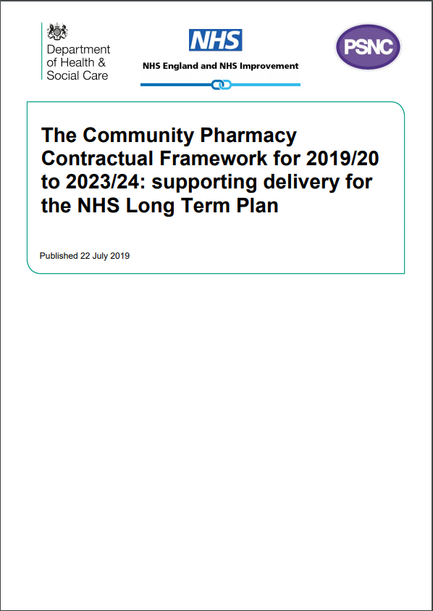
Summary of the deal
£13 billion investment over 5 years
£2.592bn a year
Funding protected from further cuts
Sets out a clear vision for our services – in line with pharmacy’s asks in the Community Pharmacy Forward View
Annual Review points to ensure full global sum is utilised

Slide 5
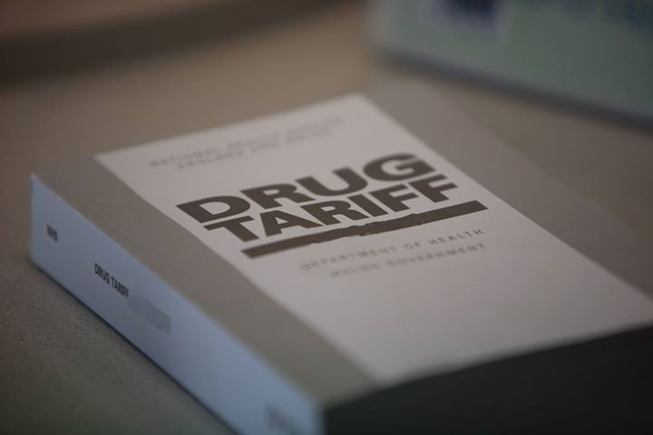
October Drug Tariff
Many aspects remain unchanged e.g. Single Activity Fee, New Medicines Service, Pharmacy Access Scheme etc.
Pharmacy Quality Scheme – Payment end March / early April
CPCS fee set at £14.00
Serious Shortage Protocol fee set at £5.35

Slide 6
October Drug Tariff Transitional Payments
Transitional Payments will ensure full 2.592bn is delivered
Monthly Transitional payment is based on items dispensed in the months from 1st Oct – March 2020, as follows:
0 - 2,500 £100.00
2,501 - 5,000 £700.00
5,001 - 19,167 £780.00
19,168+ £833.33
The aim is to help contractors prepare for a more
service-based role and engage with Primary
Care Networks
Transitional Payments for 20/21 are still to be agreed

Slide 7
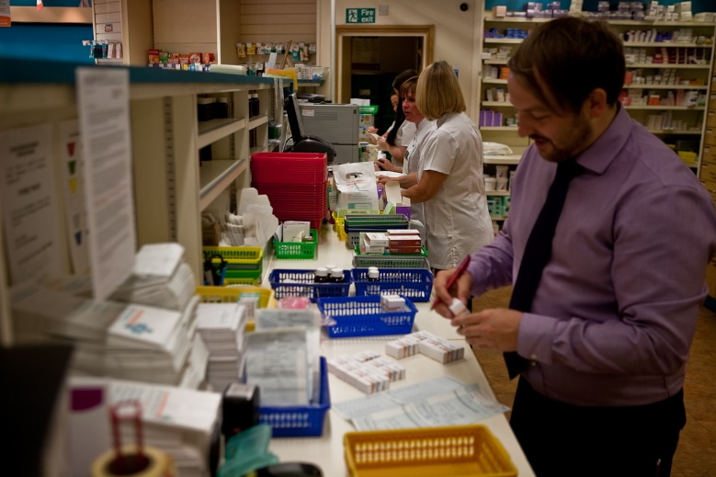
What does this mean for your businesses?
Difficult financial situation remains, and huge challenges lie ahead
The deal means major changes for all pharmacy businesses
The deal guarantees a future for those up for change
Specific challenges will be around:
dispensing efficiencies
freeing up pharmacists’ time
wider use of clinical workforce
branch viability and consolidations
coming together locally in PCNs
working closer with GPs
NOW IS THE TIME TO ADAPT

Slide 8
Clinical Services: Medicines Use Reviews
MURs to be phased out as Structured Medication Reviews carried out by clinical pharmacists working within PCNs are introduced
Contractors will be able to provide up to
250 MURs during 2019/20 (max. 200 in H1)
100 in 2020/21
From 1st October 2019/20, 70% of MURs must be for patients taking high-risk meds or post-discharge

Slide 9
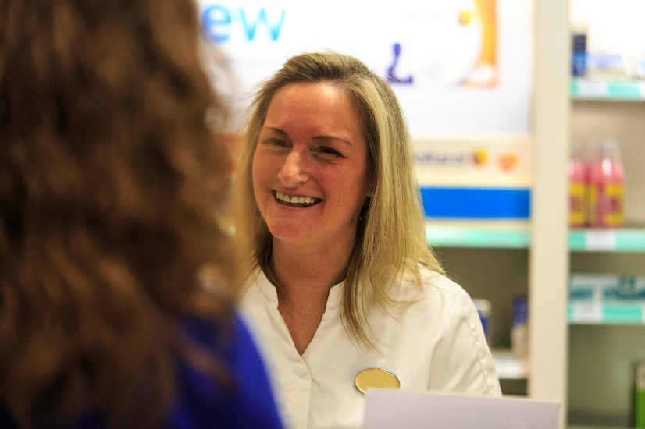
Clinical Services: Prevention
Level 1 Healthy Living Pharmacy an essential requirement by 1st April 2020
Hepatitis C testing to be introduced in 2019/20
open to people using needle and syringe programmes
probably commissioned as an Advanced service
time limited service
Pilots of prevention services e.g CVD, vaccination, point of care testing for minor illness, stop smoking referrals from secondary care.

Slide 10
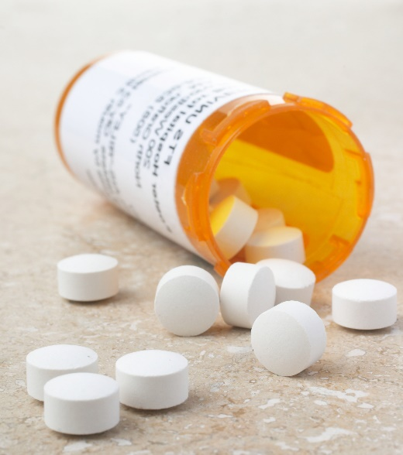
Clinical Services: Medicines Optimisation
Medicines reconciliation service to ensure changes in medication made in secondary care are implemented when patient discharged into the community
Consider NMS expansion to include further conditions
New service to improve access to palliative care medicines to be piloted

Slide 11
Summary of the deal
 | Oct 2019 – Mar 2020 | Apr 2020 – Mar 2021 | Apr 2021 – Mar 2024
Funding | Flat funding of £2,592bn Consulting on changes to reimbursement | Flat funding – review in Oct 2020 Establishment Payment Phased out | Flat Funding – review in Oct 2021 Increase share of funding for clinical services
Pharmaceutical Services | MUR capped at 250 – target PCN pharmacists to start SMRs | MURs capped at 100 & phased out Medicines Reconciliation Service | Palliative care medicines service Scope of NMS expanded Routine monitoring of patients under eRD (e.g. oral contraception)
Consultation service (CPCS) | NHS 111 service introduced in Oct 19 Fee of £14 per intervention | GP referral service due to be introduced | Urgent treatment referrals A&E referrals Point of Care Testing
Public Health | Hep C testing service | HLP Level 1 status becomes mandatory | BP & AF case finding Stop smoking referrals Early cancer diagnosis
Pharmacy Quality Scheme | Prepare to engage with PCNs Prescribing safety Diabetes patient checks | Suicide prevention training Inhaler technique audit Anticoagulation audit | Details to be confirmed
Regulations | Mergers & closures – Hub & Spoke – Original Pack Dispensing – Empower technicians

Slide 12
The Pharmacy Quality Scheme & Terms of Service Changes

Slide 13
Terms of Service
New Terms of Service requirements from 1st April 2020:
Healthy Living Pharmacy Level 1 ( 3 years valid certification of training)
Consultation room ( IT accessible)
NHSmail - ACTIVE
Summary Care Records access ( not 1x year)
NHS 111 Directory of Services
NHS.UK pharmacy profile updating
All pharmacies must be able to use EPS

Slide 14
Quality: Pharmacy Quality Scheme (PQS)
Quality Payment Scheme is replaced by Pharmacy Quality Scheme (PQS)
Makes more of ‘Quality’ rather than ‘payments’
Incentives have an annual value of £75m
Some quality criteria grouped into bundles for payment
Aspiration payment - up to 70% of QPS earnings from 2018/19 could be claimed by 1st Nov.

Slide 15
Gateway Criteria
Offering Flu Vaccination Service and/or NMS
Active shared premises NHSmail mailbox, with two linked accounts
Update NHS website profile between 1st October and 30th November
Level 2 safeguarding status for 80% of pharmacy professionals

Slide 16
Quality Domains
The Pharmacy Quality Scheme is now split into 6 domains or bundles:
Risk management and safety
Medicines safety audits (which complement the GP equivalent QOF module)
Prevention
Primary Care Networks (PCNs)
Asthma
Digital enablers
New: The whole domain must be completed to be able to meet it, unlike previous schemes

Slide 17
Quality – PQS Quality Criteria​
Risk Management and Safety Composite Bundle (30 points, min. £1920)
CPPE Risk Management training and assessment
Update the previous risk review and record risk minimisation actions taken
CPPE Sepsis online training and assessment with risk mitigation and risk review entry
CPPE online training and assessment on LASA errors
New safety report including a focus on LASA errors

Slide 18
Quality – PQS Quality Criteria
Medicines Safety Audits complementing the GP Quality Measures (25 points, min. £1600)
Lithium
Valproate ( see template on PharmOutcomes)
Repeat of the NSAIDs and gastro-protection audit (2 week audit)
Asthma Plan and evidence of referrals (5 points, min. £320)
THIS IS THE LAST WEEK TO START THE AUDITS

Slide 19
Quality – PQS Quality Criteria
Primary Care Networks (12.5 points, min. £800; 10 points for pharmacy PCN leads)
Demonstrate that pharmacies in a PCN area have agreed a collaborative approach to engaging with their PCN
Digital enablers:
NHS 111 DoS profile and SCR access (2.5 points, min. £160)
UPDATE BEFORE THE 30TH NOVEMBER

Slide 20
Quality – PQS Quality Criteria​
Prevention Composite Bundle (25 points, min. £1600)
HLP level 1 (self-assessment & 3 years validation)
All patient-facing staff are Dementia Friends- check for new staff !
Dementia friendly environment standards checklist (New requirement)
Discussions with all patients 12yrs + with diabetes re. annual foot and eye checks & record on PMR
Reduction in volume of Sugar Sweetened Beverages sold by the pharmacy (10% or less) – Just sell water !

Slide 21
VirtualOutcomes
SUITE OF EASY TO FOLLOW COURSES : SEPSIS, DIABETIC & EYE CARE, PQS, HLP
and much more. Easily accessed on IPAD, Smartphone

Slide 22
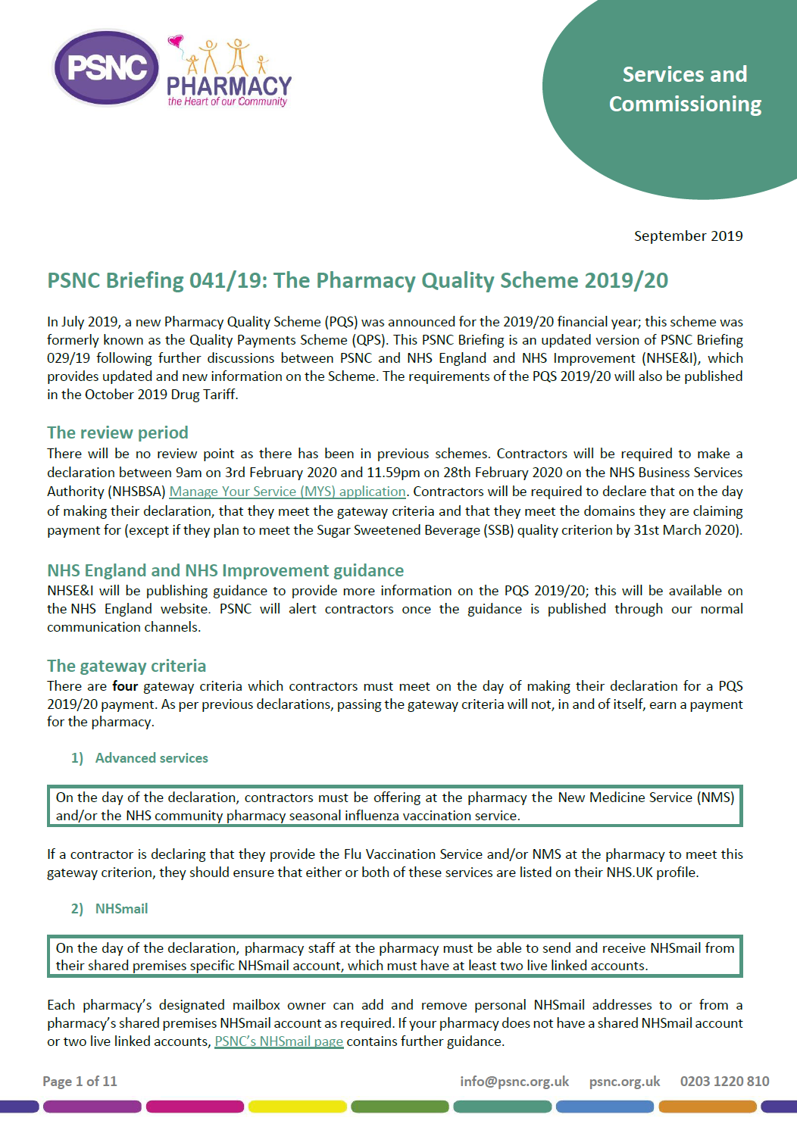
Quality - PQS declaration & Resources
Declaration period:
9am 3rd Feb - 11.59pm 28th Feb 2020
PSNC Briefing 041/19 contains the most up to date information
Visit the HSHK LPC Website
Keep abreast of the deadlines LPC Monthly Tracker
Visit psnc.org.uk/PQS for detailed information
Join our Social Media ‘closed’ Facebook Groups
Halton,St Helens & Knowsley LPC Group

Slide 23
Primary Care Networks (PCNs)

Slide 24
What are Primary Care Networks?
GP practices (covering a population of 30,000 to 50,000 patient) joining together as groups of practices to deliver the GP contract
Working with community service providers and other health and care organisations, including community pharmacies
All GPs are aligned to a PCN in Halton, St Helens & Knowsley
PCN’s are at the heart of the NHS Long Term Plan
Developing integrated care systems with primary care networks as the foundation
Everyone gets the best start in life
World class care for major health problems
Supporting people to age well

Slide 25
How will PCNs improve primary care?
By strengthening and redesigning health and social care by bringing together a range of professionals to work together to provide enhanced personalised and preventative care for their local community
By providing the structure and funding for services to be developed locally, in response to the needs of the patients they serve
By having aligned clinical and financial aims and a unified, capitated budget – making joint decisions on how funding is spent
By sharing resources, PCNs will be able to employ a broader range of staff, extend services or offer new services

Slide 26
Why should community pharmacies get involved?
It is important that community pharmacy teams are fully engaged in the work of PCNs:
to optimise their provision of services to patients
the future development of local services will be influenced by PCNs
NHS England sees the initial priorities for community pharmacy engagement in PCNs to be:
supporting the provision of integrated urgent care services, e.g. CPCS
work on prevention, such as provision of public health interventions and services, building on the work of HLPs
These priorities are reflected in the changes to the community pharmacy and GP contracts

Slide 27
How can community pharmacies get involved?
Your LPC has mapped you to a PCN (or even 2) - Let us know if you think we have it wrong
Look at the pack provided to you and absorb the information within
Know and understand who is in your network
Start WORKING TOGETHER
Consider how you can develop or enhance relationships with local health and care providers, particularly GP practices (especially clinical pharmacists working there)
Notes:
.

Slide 28
Next Steps
Community Pharmacy PCN Comms
Decide how you want to communicate with each other
LPC suggestion is that e- mail hubs are set up for each network which will include all pharmacies and LPC
Other suggestions are welcome
Identify your Community Pharmacy PCN Lead
Look at the Principles on the tables
Decide if you want to put yourself forward as a lead for your PCN
LPC will collate EOIs from tonight, from other events, as well as ensuring that those who have not attend have an opportunity to get involved
If there is more than one EOI than the LPC will support the network with next steps

Slide 29
Break Out Session

Slide 30
Feedback and Actions
Stay up-to-date on the current NHS landscape (check the PSNC and LPC website regularly)
Stay in touch with LPC for regular updates on local activity / developments
Read the newsletter
Print and use the tracker
Print and use other guidance issues for example CPCS Top Tips and Locum guide

Slide 31
NHS Community Pharmacist Consultation Service

Slide 32
NHS Community Pharmacist Consultation Service
National rollout from 29th October 2019
Referrals to pharmacies from NHS 111
Replaces NUMSAS and local DMIRS pilots
NUMSAS ENDED on 28th October
Around 700 Urgent supply referrals a month currently – this will continue
Anticipation that the Minor Illness side will eventually match the numbers of Urgent supplies
Urgent supply NHS111 online pilot continues

Slide 33
CPCS: why it’s important
Dr Bruce Warner, Deputy Chief Pharmaceutical Officer said:
“It represents a major step change in the service the NHS provides to patients and fully uses the clinical skills and expertise local pharmacists have to offer as the ‘go to first’ point of call for people with minor illnesses.
“It’s an exciting time and it establishes community pharmacies as a major clinical provider within the NHS.”
Opportunity to prove our clinical capabilities through the CPCS and to make a case for further investment in the service as it expands

Slide 34
NHS Community Pharmacist Consultation Service
Transitional payment of:
£900 if signed up by 1st December 2019; or
£600 by 15th January 2020
You can now register via MYS
Fee of £14 per completed consultation
Can supply medicine via CATC. Must record CATC separately.
Follow up calls to no-show patients reduced to one (from three)
CPCS Service Expansion: Pilots with referrals from GPs, NHS 111 online, Urgent Treatment Centres and possibly A&E

Slide 35
Service Delivery – Key points for consideration before signing up
The pharmacy must meet the requirements of their essential services
The service must be operational over all opening hours
Locums must be able to offer the service
The Pharmacist must ensure that patients leave having had their query fully dealt with
Minor illness - Face to face consultation is expected to include the recognition of any Red Flags
Onward referrals may be necessary to other urgent care services or the patient’s own GP – this must be arranged by the pharmacist
There must always be access to SCR, PharmOutcomes, NICE CKS and The NHS mail shared mailbox
From 1st April 2020 – MUST have IT access in Consultation room – Laptop not Chrome book

Slide 36
Top 10 conditions NE

Slide 37
DMIRS NE Consultations

Slide 38
Lessons learnt from the Minor illness pilot sites
Staff can’t log into PharmOutcomes
Staff can’t access NHSmail
Staff can’t access SCR
Warm transfer - Practice receptionist wouldn’t let me make appointment – speak to GPs
Need to manage the expectations of the patient – CPCS is a clinical assessment service which may require onward referral.

Slide 39
PharmOutcomes Guides

Slide 40
PharmOutcomes Guides + Videos

Slide 41
Annex C details

Slide 42
Solutions
Ensure staff can access PharmOutcomes.
Show locums where to access PharmOutcomes guides and videos.
Accessible PharmOutcomes log on details for locums.
Set up a CPCS locum file and use the LPCs Locum checklist form.
Set up a locum pack – Include a copy of the LPC Urgent supply Top Tips.
SCR – have a working smart card + access from within PharmOutcomes.
NHSmail – set up multiple staff to access the NHS shared mailbox.
Annex C information – Now on a PharmOutcomes template

Slide 43
Closing Points
Global sum is flat for the next 5 years
Pharmacies must adapt to reduce their reliance on dispensing income
Shift to more service based contract
Maximise Pharmacy Quality Scheme income
Pharmacies will need to work together more closely in PCNs and with GP practices
There are ways of replacing and enhancing income through new services
The CPCS is VITAL to the success of the rest of the 5-year deal

Slide 44
Questions

Slide 45
Thank You and Good Night

